Slide 1
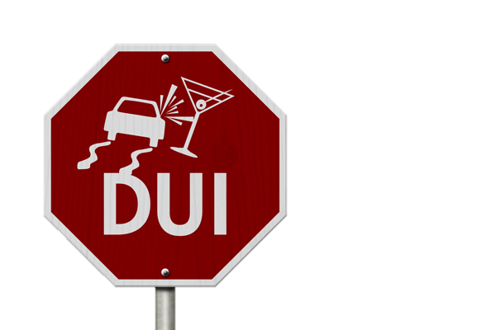
Federal DUIs
Carrie Corcoran
AFPD/Misdemeanor Supervisor
Office of the Federal Public Defender
100 South Charles Street
Tower 2, 9th Floor
Baltimore, MD 21201
Carrie_Corcoran@fd.org
c (410) 207-4219

Slide 2
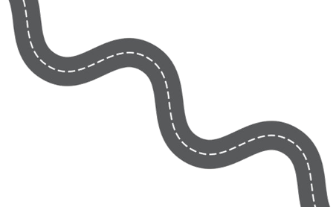
Where do federal DUIs originate?
Military Bases in Maryland
  Aberdeen Proving Ground, Ft. Detrick, Ft. Meade (including NSA), US Naval Academy, Joint Base Andrews, Patuxent Naval Air Station, Walter Reed National Military Medical Center
Federal Parkways
  Baltimore Washington Parkway, Clara Barton Parkway, Suitland Parkway
National Parks
  C&O Canal National Historic Park, Greenbelt Park, Oxon Hill Farm, Assateague Island National Seashore
Federal Buildings and Other Property
  Post Offices, Veterans Hospitals, Social Security Administration, Suitland Federal Center, War Memorial, Beltsville Agricultural Research Center, Goddard Space Flight Center

Slide 3
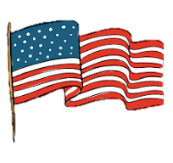
What law applies to federal misdemeanor cases in Maryland?
Federal Statutes –
    Theft of Government Property – 18 USC §641
    Theft of Personal Property – 18 USC §661
    Assault – 18 USC §113
    Assault on a Federal Officer – 18 USC §111
    Possession of Drugs – 21 USC §844(a)
    Trespassing – 18 USC §1382
    Destruction of Property – 18 USC §1351
    Obstruction of Mail – 18 USC §1701
    Possession of Firearm at Federal Facility – 18 USC §930
    Fish & Wildlife Crimes – 16 USC §§3371-3378

Slide 4

There is no federal
DUI statute.

Slide 5
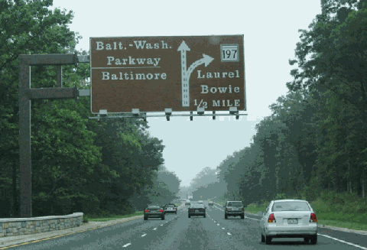
If no federal statute applies, does a federal regulation apply?
Federal Agency Regulations –
  National Inst. of Standards & Tech. – 15 CFR §265
  National Security Agency – 32 CFR §228
  Federal Highways – 36 CFR §1-4
  Assateague Island National Seashore – 36 CFR §7.65
  Patuxent Wildlife Refuge – 36 CFR §50
  Veteran’s Administration – 38 CFR §1.218
  Post Offices – 39 CFR §232.1
  Social Security Admin. – 41 CFR §§102-74.375-440
  National Institutes of Health – 45 CFR §3
  Wildlife Offenses – 50 CFR §20

Slide 6

If no federal statute or regulation applies, Maryland law fills the gaps.
Assimilated State Statutes —
The Assimilative Crimes Act, 18 U.S.C. §13, borrows state law to fill gaps in federal criminal law for offenses committed on federal property. Title 18 U.S.C. §7 (d) defines "special maritime and territorial jurisdiction of the United States" to include, inter alia,
    “(3) Any lands reserved or acquired for the use of the United States, and under the exclusive or concurrent jurisdiction thereof, or any place purchased or otherwise acquired by the United States by consent of the legislature of the State in which the same shall be, for the erection of a fort, magazine, arsenal, dockyard, or other needful building.”

Slide 7

#1 - Military Base Cases
Federal cases originating from conduct on military bases:
assimilate Maryland substantive law
assimilate Maryland penalty provisions
federal procedural law applies

Slide 8

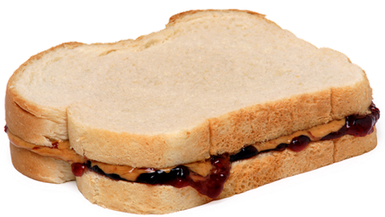
Military Base Cases
Can I get a PBJ?

Slide 9
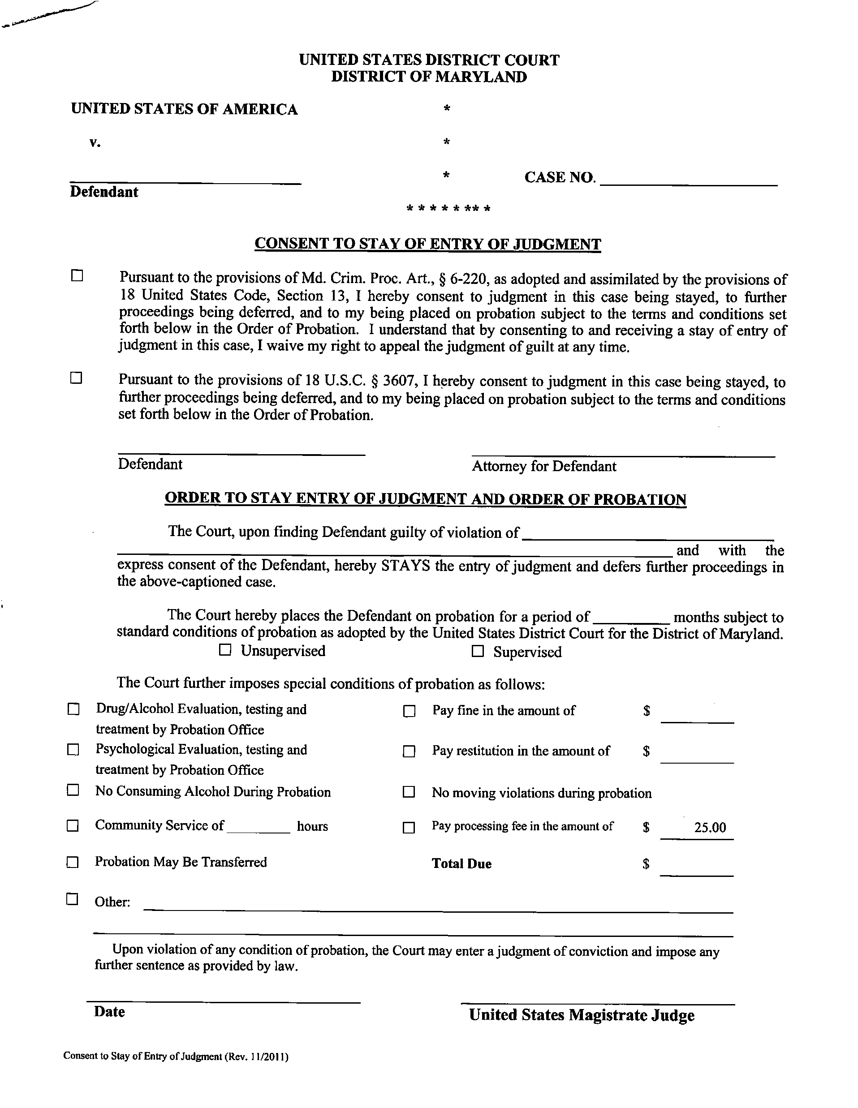



Slide 10
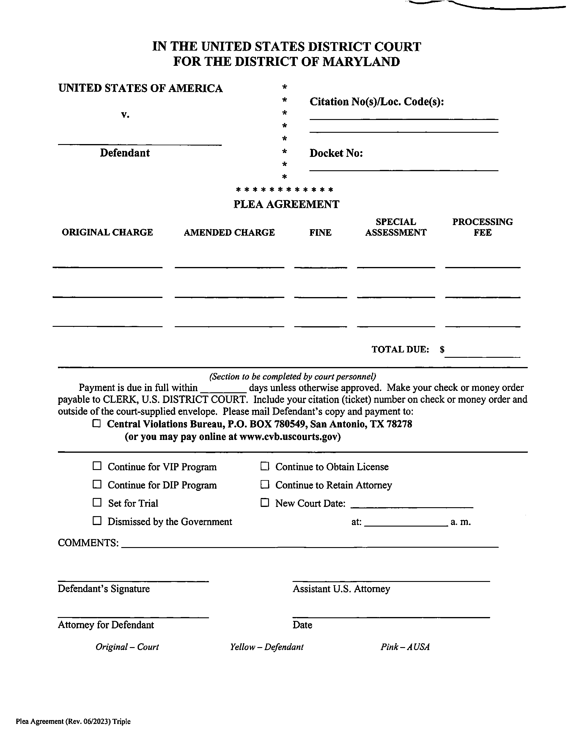

Slide 11
Civil Offenses Cannot be Assimilated
United States v. Rowe, 599 F.2d 1319 (4th Cir. 1979) holds that civil offenses cannot be assimilated under the Assimilative Crimes Act.
This comes up in military base cases charging possession of an open container under Md. Crim Code § 10-125, defined as a civil offense at Md. Crim Code §10-126.

Slide 12
Military Base Cases – Quiz
Does federal or Maryland law apply?
What constitutes driving?
01
What penalty applies?
02
Will I get points? Yes.
03
What Rules of Evidence Apply?
04
How much time to I have to file an appeal?
05
Follow Maryland Law
Follow Maryland Law
Follow Maryland Law
Follow
Federal Rules
Follow
Federal Rules

Slide 13

#2 - Federal Roadways, Parks, and Facilities
Federal cases originating from conduct on federal roadways, parks, and federal facilities apply:
    substantive federal CFR law
    federal penalty provisions
    federal procedural law

Slide 14

Federal DUI CFR for Parkways
4.23 Operating under the influence of alcohol or drugs.
(a) Operating or being in actual physical control of a motor vehicle is prohibited while:
(1) Under the influence of alcohol, or a drug, or drugs, or any combination thereof, to a degree that renders the operator incapable of safe operation; or
(2) The alcohol concentration in the operator's blood or breath is 0.08 grams or more of alcohol per 100 milliliters of blood or 0.08 grams or more of alcohol per 210 liters of breath. Provided however, that if State law that applies to operating a motor vehicle while under the influence of alcohol establishes more restrictive limits of alcohol concentration in the operator's blood or breath, those limits supersede the limits specified in this paragraph.
(b) The provisions of paragraph (a) of this section also apply to an operator who is or has been legally entitled to use alcohol or another drug.

Slide 15

Elements of a CFR DUI
The elements of § 4.23(a)(1) are:
operating or in actual physical control of a vehicle;
while under the influence of alcohol, or a drug, or drugs, or any combination thereof, to a degree that renders the driver incapable of safe operation; and,
within the boundaries National Park Service (NPS) lands.
See United States v. Davis, 261 F.Supp.2d 343, 347 (DMd.2003). United States v. Atkinson, 128 Fed.Appx. 64, 65 (10th Cir.2005); see also United States v. Salter, 28 F.3d 110 (9th Cir.1994).
“Actual Physical Control” - US v. McFarland, 369 F.Supp.2d 54 (DMe. 2005) (Defendant who was discovered asleep behind wheel of parked vehicle in parking lot was in “actual physical control” of vehicle, for purposes of misdemeanor conviction of driving while intoxicated under 36 CFR § 4.23(a), where he was owner of vehicle, no other person was near vehicle, keys were in ignition, and hood of vehicle was warm).

Slide 16

Federal Law Regarding Testing
§ 4.23 Operating under the influence of alcohol or drugs.
(c) Tests.
(1) At the request or direction of an authorized person who has probable cause to believe that an operator of a motor vehicle within a park area has violated a provision of paragraph (a) of this section, the operator shall submit to one or more tests of the breath, saliva, or urine for the purpose of determining blood alcohol and drug content.
(2) Refusal by an operator to submit to a test under paragraph (c)(1) is prohibited and proof of refusal may be admissible in any related judicial proceeding.
(3) Absent exigent circumstances, an operator cannot ordinarily be required to submit blood samples for the purpose of determining blood alcohol and drug content unless it occurs through a search warrant. An authorized person who has probable cause to believe that an operator of a motor vehicle within a park area has violated a provision of paragraph (a) of this section shall get a search warrant, except when exigent circumstances exist, to obtain any blood samples from the operator for the purpose of determining blood alcohol and drug content.
(4) Any test or tests for the presence of alcohol and drugs shall be determined by and administered at the direction of an authorized person.
(5) Any test shall be conducted by using accepted scientific methods and equipment of proven accuracy and reliability operated by personnel certified in its use.

Slide 17
No Presumptions
§ 4.23 Operating under the influence of alcohol or drugs.
(d) Presumptive levels.
(1) The results of chemical or other quantitative tests are intended to supplement the elements of probable cause used as the basis for the arrest of an operator charged with a violation of paragraph (a)(1) of this section. If the alcohol concentration in the operator's blood or breath at the time of testing is less than alcohol concentrations specified in paragraph (a)(2) of this section, this fact does not give rise to any presumption that the operator is or is not under the influence of alcohol.
(2) The provisions of paragraph (d)(1) of this section are not intended to limit the introduction of any other competent evidence bearing upon the question of whether the operator, at the time of the alleged violation, was under the influence of alcohol, or a drug, or drugs, or any combination thereof.
See also US v. Sauls, 981 F. Supp 909 (DMd. 1997) (Maryland presumptions do not apply and reasonable time for administering breath test will ordinarily be test administered within three hours of time of driving; however, test administered beyond three hour limit will not necessarily preclude admissibility of test result or application of appropriate permissible inferences in federal driving while intoxicated prosecution).

Slide 18
Refusal
Refusal can be charged as a separate offense under 36 CFR 4.23(c)(2). See US v. Sugiyama, 113 F. Supp.3d 784(DMD 2015).
Cannot refuse breath, saliva, or urine without getting charged
CAN refuse blood draw without getting charged

Slide 19
Unsafe Operation
§ 4.22 Unsafe operation.
(a) The elements of this section constitute offenses that are less serious
than reckless driving. The offense of reckless driving is defined by State law and violations are prosecuted pursuant to the provisions of section 4.2 of this chapter.
(b) The following are prohibited:
(1) Operating a motor vehicle without due care or at a speed greater than that
which is reasonable and prudent considering wildlife, traffic, weather, road and
light conditions and road character.
  (2) Operating a motor vehicle in a manner which unnecessarily causes its tires to
  squeal, skid or break free of the road surface.
  (3) Failing to maintain that degree of control of a motor vehicle necessary to
  avoid danger to persons, property or wildlife.

Slide 20
Offenses not defined by CFR
§ 4.2 State law applicable.
(a) Unless specifically addressed by regulations in this chapter, traffic and the use of vehicles within a park area are governed by State law. State law that is now or may later be in effect is adopted and made a part of the regulations in this part.
(b) Violating a provision of State law is prohibited.

Slide 21

CFR Convictions and Driving Records
Convictions for CFR offenses appear on Maryland driving records, but no points are assessed.
Convictions for CFR offenses do not appear on DC or Virginia driving records.
To avoid assessment of points for CFR offenses:
    Be sure that the original ticket charges a CFR offense, or
    If the original ticket references a Maryland offense because the CFR did not specifically make the conduct unlawful (e.g., operating uninsured), be sure that the plea agreement or Judgment indicate that the plea was to an amended offense under 36 CFR 4.2.

Slide 22
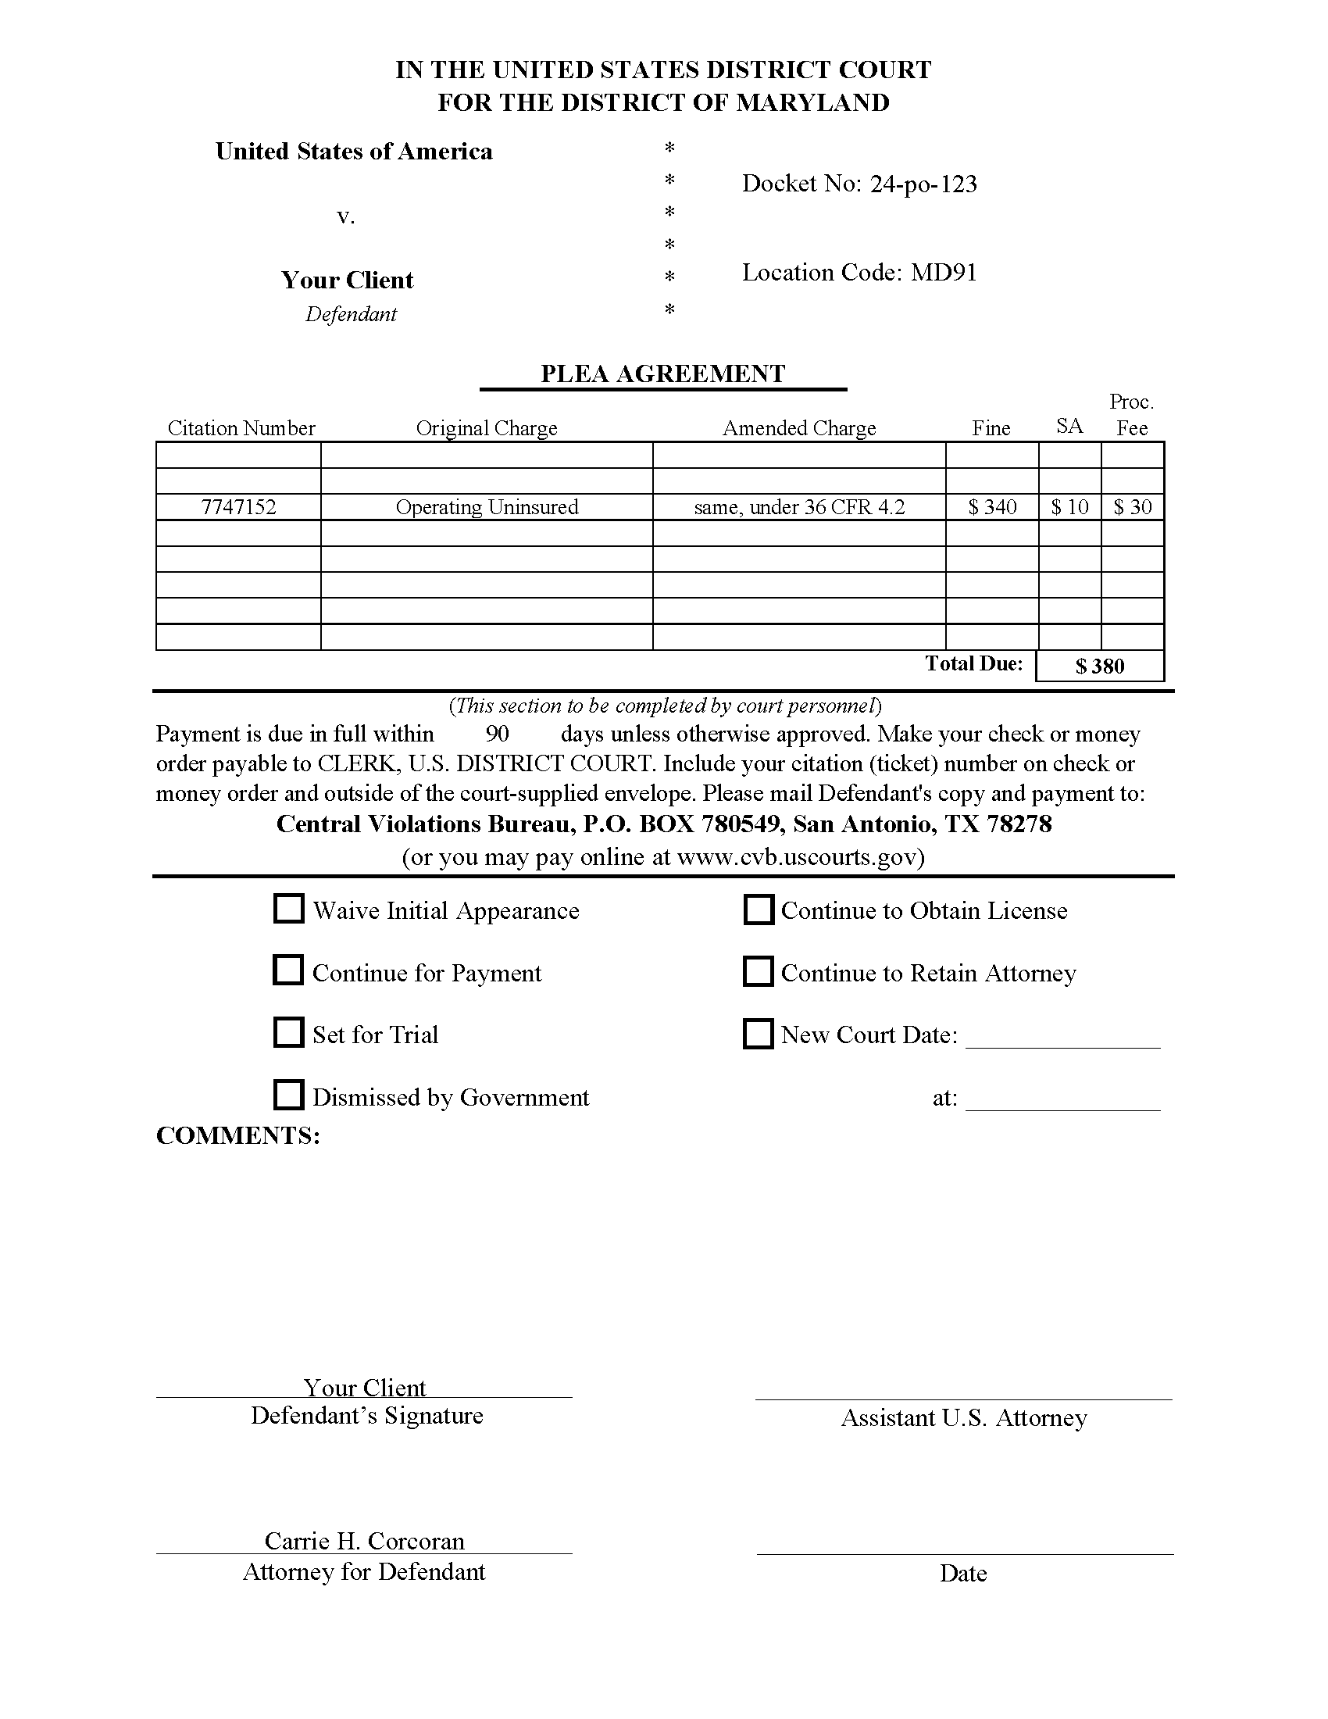

Slide 23
CFR Penalties
All traffic offenses on the Greenbelt Park Police
dockets carry the same punishment: 6 months
and $5000 max. See 36 CFR 1.3 (c), referencing
18 USC 1865.
Yes, speeding and DUI carry the same penalty
on the B/W Parkway, Clara Barton Parkway,
and Suitland Parkway.

Slide 24


Blood Draw Warrants
Blood Draw Warrants are only requested in the District of Maryland in Greenbelt Park Police cases involving accidents with bodily injury or death.

Slide 25
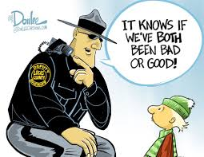
BWC
Military Police do not use BWC.
Since Fall 2022, all National Park Service law enforcement officers wear body-worn cameras in the performance of their duties, subject to the guidelines set forth in Reference Manual 9 Chapter 44 Law Enforcement Recording Devices, and USPP General Order 80.00 Body-Worn Camera Program

Slide 26
Sufficiency of Evidence
United States v. Nestor, 474 F.Supp.2d 174 (DMe. 2007) (BAC of .10 was subject to error rate such that credible evidence established only that motorist had a blood alcohol level greater than 0.05% and less than 0.08% at the time of operation; this BAC was insufficient to prove beyond a reasonable doubt that the motorist operated a motor vehicle at a time when his consumption of alcohol rendered him incapable of safely doing so; there was no evidence of unsafe operation, no evidence of extreme intoxication, and no expert testimony regarding the significance of blood test results vis-à-vis an ability to safely operate as distinct from being influenced to some degree by alcohol.

Slide 27

Classification of Offenses
18 USC §3559(a)
Class A misdemeanors — 18 USC § 3559 (a)(6) - maximum penalty is 1 year of incarceration and $100,000 fine
Petty offenses — defined in 18 USC §19 as Class B misdemeanors, Class C misdemeanors and infractions
      Class B misdemeanors — 18 USC 3559(a)(7) - max penalty is more than 30 days but fewer than 6 months with a max fine of $5000
      Class C misdemeanors — 18 USC 3559(a)(8) - max penalty penalty is more than 5 days but fewer than 30 days with a max fine of $5000
      Infractions — 18 USC 3559(a)(9) - max penalty is 5 days or fewer with a max fine of $5000

Slide 28

Right to a Jury Trial and District Judge
18 USC §3401(b)
Under 18 U.S.C. §3401(b), Class A misdemeanor cases can be tried with or without a jury before a Magistrate or District Judge. Clients have 4 trial options.
A defendant charged with a Class A misdemeanor must consent in writing or on the record to proceeding before a Magistrate Judge.
Petty offenses do not trigger the right to a jury trial or a District Judge. The only trial option for a petty offense (charge carrying 6 months or less) is a bench trial before a Magistrate Judge.

Slide 29
Federal Magistrate Judge Authority
18 USC § 3401(a) and 28 USC § 636(a)(3)-(5)
Under 18 USC § 3401(a) and 28 USC § 636(a)(3)-(5), Magistrate Judges are authorized to try and dispose of any misdemeanor in federal court.

Slide 30
Speedy Trial
18 USC §3161
Only applies to Class A misdemeanors
Trial shall commence within 70 days of the filing of the information or indictment or the defendant’s first appearance before a court where the charge is pending, whichever happens last.
Trial shall commence within 70 days if the defendant is charged by criminal complaint and consents in writing to be tried by a Magistrate Judge.
Trial shall not start within 30 days of the defendant’s first court appearance.
Sanction is dismissal with or without prejudice.

Slide 31
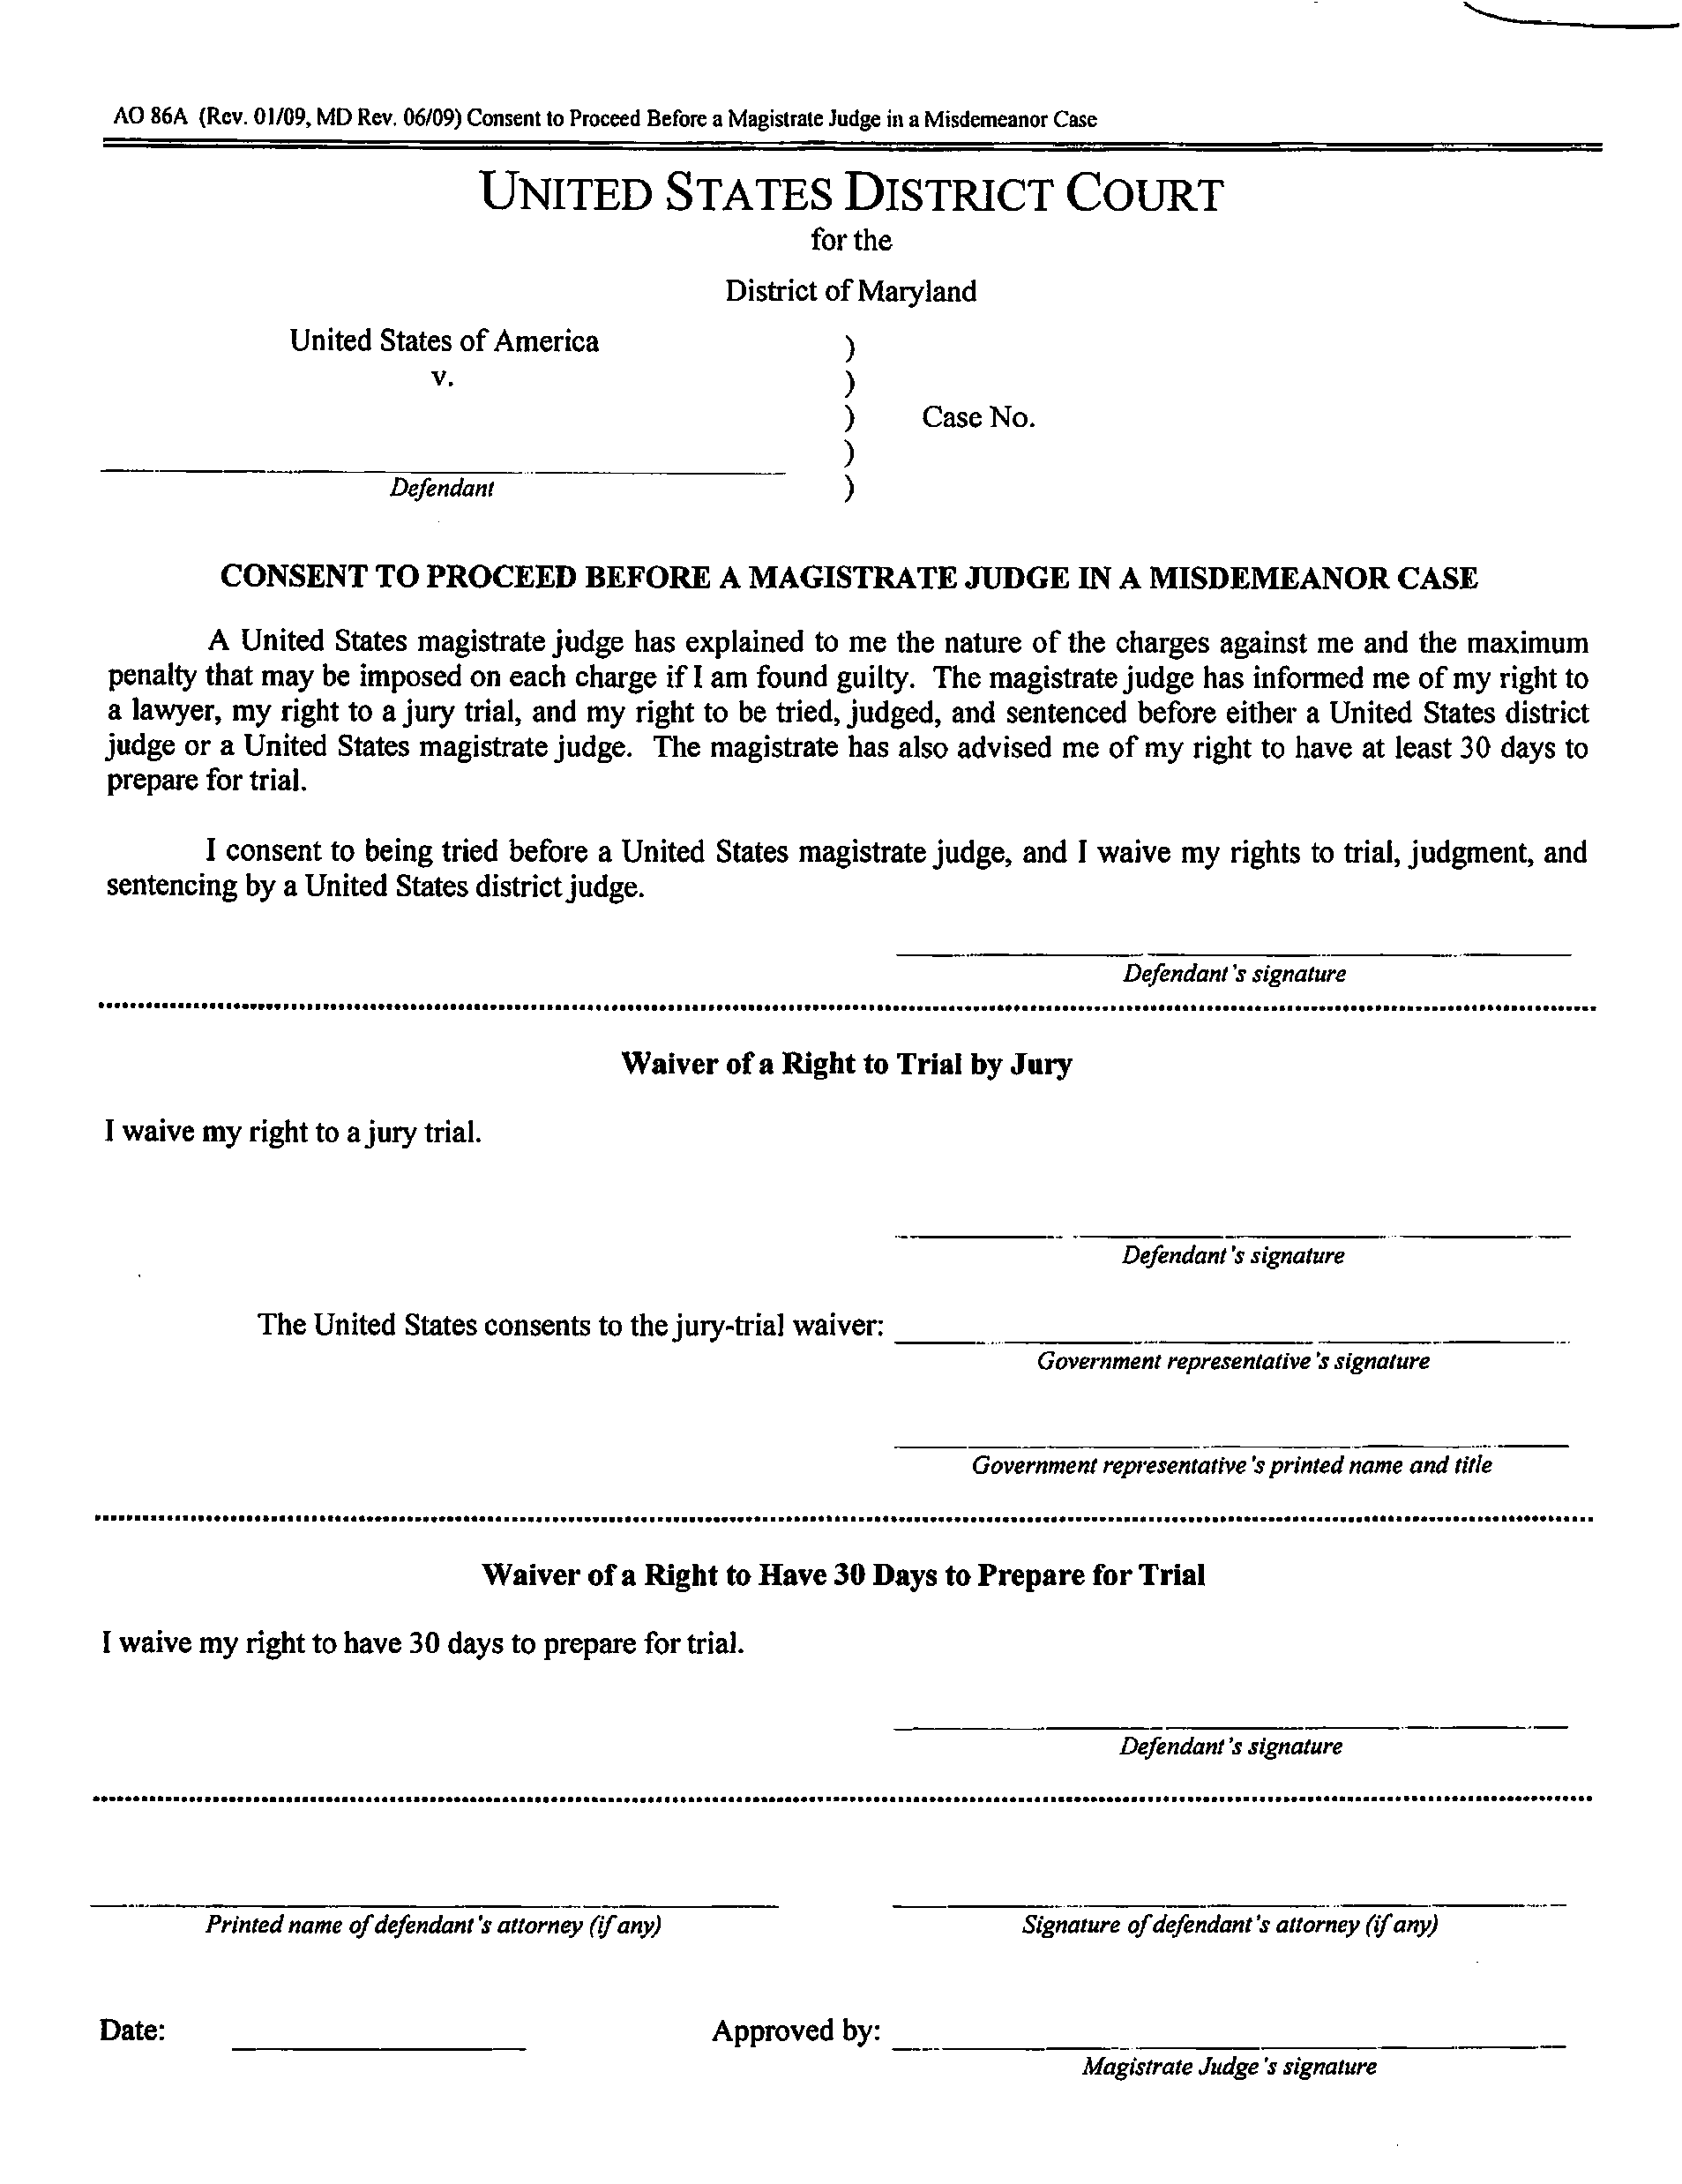

Slide 32
Federal Procedural Rules and Standing Orders
Federal Rule of Criminal Procedure 58 – Rules Governing Misdemeanor Cases
    Rule 58 (b)(1) provides that any misdemeanor can be charged by indictment, information or complaint and a petty offense can also proceed on a citation or violation notice.
    By implication, a Class A misdemeanor cannot proceed to trial if charged solely by violation notice.

Slide 33
Federal Procedural Rules and Standing Orders
(continued)
Federal Rule of Criminal Procedure 43(b) – Defendant’s Presence
(b) When Not Required. A defendant need not be present . . . (2) Misdemeanor Offense. The offense is punishable by fine or by imprisonment for not more than one year, or both, and with the defendant's written consent, the court permits arraignment, plea, trial, and sentencing to occur by video teleconferencing or in the defendant's absence.

Slide 34
Federal Procedural Rules and Standing Orders
(continued)
Federal Rule of Criminal Procedure 43(c) -
Waiving Continued Presence.
(1) In General. A defendant who was initially present at trial, or who had pleaded guilty or nolo contendere, waives the right to be present under the following circumstances:
(A) when the defendant is voluntarily absent after the trial has begun, regardless of whether the court informed the defendant of an obligation to remain during trial;
(B) in a noncapital case, when the defendant is voluntarily absent during sentencing; or
(C) when the court warns the defendant that it will remove the defendant from the courtroom for disruptive behavior, but the defendant persists in conduct that justifies removal from the courtroom.
(2) Waiver's Effect. If the defendant waives the right to be present, the trial may proceed to completion, including the verdict's return and sentencing, during the defendant's absence.

Slide 35
Federal Procedural Rules and Standing Orders
(continued)
Standing Order 2020-01 – In Re: Discovery in Criminal Cases
Governs all federal cases, but is geared more toward felony matters
Emailing the government a discovery request is the best practice

Slide 36

Subsequent Offender Statutes
No federal DUI statute = no federal subsequent offender statute
No CFR provision has a subsequent offender provision
State subsequent offender provisions are not assimilated

Slide 37

Central Violations Bureau
Most misdemeanors arising on federal property are initiated by a federal law enforcement officer issuing a citation or “violation notice.”
Copies are provided to the defendant and to the federal judiciary's national Central Violations Bureau (CVB) in San Antonio, Texas.
Within a few months, CVB processes the violation notices, schedules appearances before magistrate judges, and sends out notices to appear. CVB also accepts payment of fines, fees and costs related to violation notices.
The CVB website is cvb.uscourts.gov.
After CVB schedules the hearing in Maryland, the District of Maryland Clerk’s Office opens the case on ECF, a case number is assigned, and all subsequent scheduling activity, entries of appearance, motions, and other case activity are filed on ECF.

Slide 38
Location of Courts and
Types of Prosecutors
Most misdemeanor proceedings occur in federal courthouses:
    Southern Division Courthouse - 6500 Cherrywood Lane in Greenbelt; all Park Police dockets are held twice a month and NIH dockets are held every other month in courtroom 1A; the government is represented by full-time Assistant United States Attorneys.
    Northern Division Courthouse – 101 West Lombard Street in Baltimore; Ft. Meade/NSA and VA/SSA/Postal dockets are held once per month in courtroom 3C. Ft. Meade prosecutors are military JAG Special AUSAs; NSA prosecutors are NSA general counsel Special AUSAs, and VA/SSA/Postal prosecutors are full-time Assistant United States Attorneys.
Remote court locations: With the exception of the Ft. Meade docket, all military base dockets are held periodically at the military bases and the prosecutors are military JAG officer Special Assistant United States Attorneys.
In 2024, Magistrate Judges stopped allowing defendants to waive their initial appearances. However, after the initial appearance, Rule 43 allows misdemeanor cases to be resolved, in the court's discretion, without the defendant's presence as long as the defendant consents in writing.

Slide 39
United States Sentencing Guidelines
Advisory federal sentencing guidelines apply to Class A misdemeanors charged under federal statutes.
Federal guidelines do not apply to Class A misdemeanors under CFR provisions or assimilated under state law for which there is no analogous guideline (e.g., DUIs).
The guidelines do not apply to petty offenses.

Slide 40
Sentencing and
Presentence Reports
Misdemeanor plea and sentencing will usually happen the same day.
PSRs are not required and are rarely used, or even mentioned, in federal misdemeanor cases.
Rule 32(c)(1) allows the parties to waive a PSR if the court finds that the information in the record is sufficient to proceed to sentencing.
PSRs rarely help the defense.

Slide 41
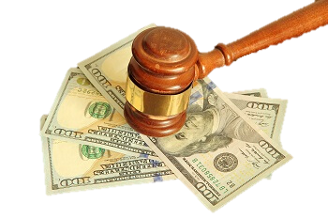
Fines, Probation, and
Supervised Release
Maximum Federal Fines – 18 USC §3571 – max of $100,000 for class a misdemeanors and max of $5000 for petty offenses (class b, c, or infractions)
Federal Probation – 18 USC § § 3561-3565 – max of 5 years for misdemeanors
Federal Supervised Release – 18 USC §3583 – max of one year for misdemeanors and can only follow jail time for a class a misdemeanor

Slide 42

License Suspensions
Maryland Licenses can be suspended for:
Failure to appear in federal court
Failure to pay a federal fine in the time allowed by the court

Slide 43
Appeals
Defendant’s appeals must be filed within 14 days after entry to judgment; the government has 30 days to appeal.
All appeals of Magistrate Judge decisions and Magistrate Court verdicts are to corresponding division of the United States District Court for the District of Maryland.
Appeals of District Judge decisions and District Court verdicts are to the 4th Circuit Court of Appeals.
Appeals are on the record reviews (not de novo).

Slide 44
Random good news!
Clients cannot be sentenced to jail and supervised release for one Class B misdemeanor offense. See 18 USC § 3583 (b)(3) (supervised release cannot follow a petty offense).
Time spent in custody for another state or federal case, after the incident date of the federal offense, that is not credited toward another sentence, shall be credited toward the federal sentence. See 18 USC § 3585(b).
DOJ no longer prosecutes possession of marijuana even if drug impairment is a basis for a DUI charge.

Slide 45
Federal DUIs
Carrie Corcoran
AFPD/Misdemeanor Supervisor
Office of the Federal Public Defender
100 South Charles Street
Tower 2, 9th Floor
Baltimore, MD 21201
Carrie_Corcoran@fd.org
c (410) 207-4219

