Slide 1

21st Annual Advanced
DUI Defense Seminar
Doubletree Hotel
Linthicum, Md.
May 9, 2025

Slide 2


Slide 3
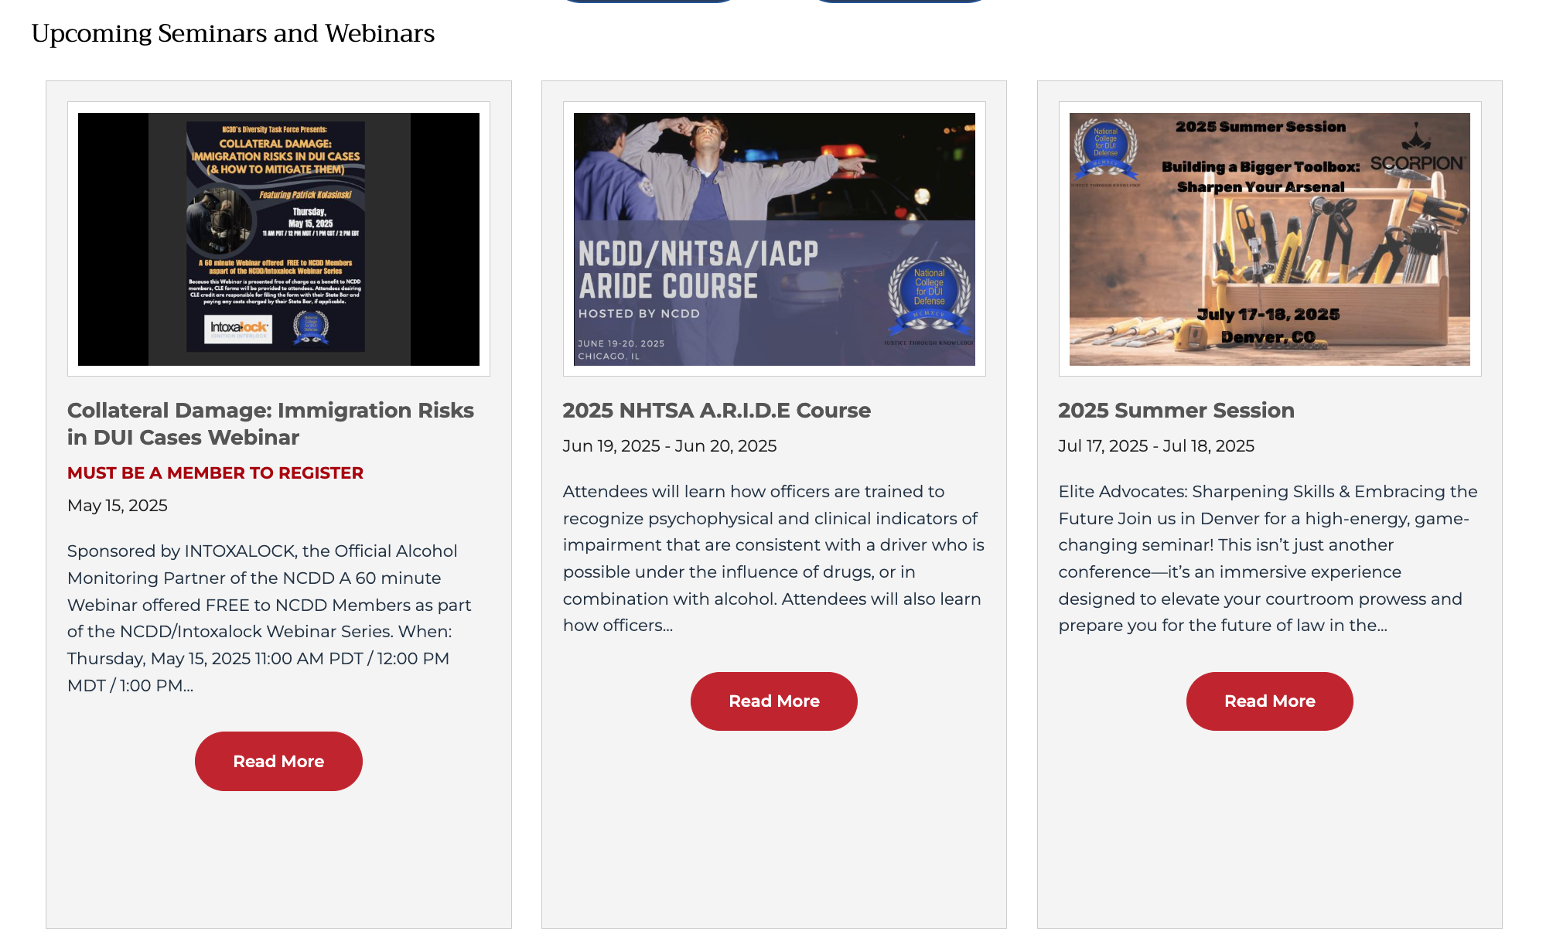

Slide 4


Slide 5
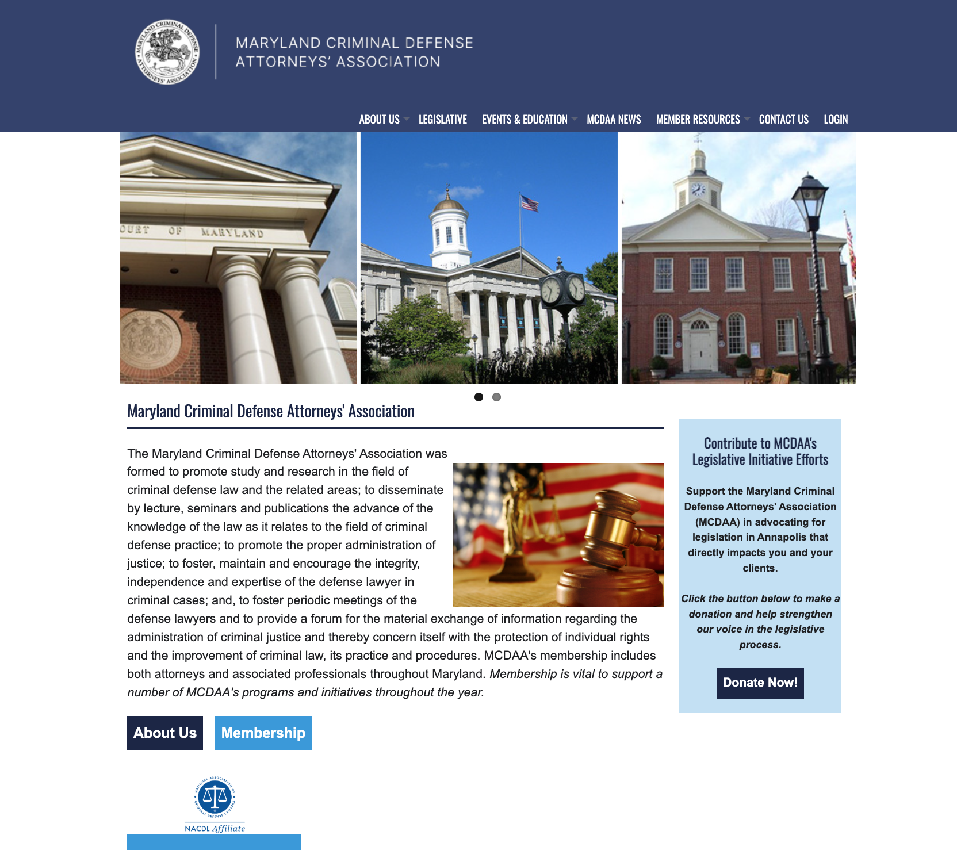

Slide 6
