Slide 1
State of Texas v. _______
County Court at Law No. _____
Honorable ________, Presiding
Troy McKinney
Schneider & McKinney, P.C.

Slide 2
Why We Are Here

Slide 3
Why We Are Here
Not in defiance of DWI Laws.
We support DWI Laws

Slide 4
Why We Are Here
Us – John did not do anything illegal.

Slide 5
Why We Are Here
Us – John did not do anything illegal.
John was not driving while intoxicated.

Slide 6
Why We Are Here
Us – John did not do anything illegal.
John was not driving while intoxicated.
State – thinks he may have been driving while intoxicated.

Slide 7
Jury Selection “Myths”
#1: Jurors “selected”
#2: If you are quiet, you do not end up serving
#3: You are required to set aside your personal feelings or experiences
#4: It is “wrong” to admit you have a bias or prejudice of some sort

Slide 8
What We Want – Good Jurors

Slide 9
What We Want – Good Jurors
Not all people are good jurors for all kinds of cases.

Slide 10
What We Want – Good Jurors
Not all people are good jurors for all kinds of cases.
We want people who want to be as good a juror as I want to be a lawyer.

Slide 11
What We Want – Good Jurors
Not all people are good jurors for all kinds of cases.
We want people who want to be as good a juror as I want to be a lawyer.
Thoughtful, attentive, inquisitive, questioning, and open-minded.

Slide 12
What We Want – Good Jurors
Not all people are good jurors for all kinds of cases.
We want people who want to be as good a juror as I want to be a lawyer.
Thoughtful, attentive, inquisitive, questioning, and open-minded.
Jurors who will follow the law – not all can, will, or want to – and that is okay. Just let us know. Everyone will respect you for your honesty.

Slide 13
Three Rules of Trial
To Prevent Wrongful Convictions
To Protect the Innocent

Slide 14
Three Rules of Trial
To Prevent Wrongful Convictions
To Protect the Innocent
Presumption of Innocence.

Slide 15
Three Rules of Trial
To Prevent Wrongful Convictions
To Protect the Innocent
Presumption of Innocence.
Level of Proof – beyond and to the exclusion of all reasonable doubt.

Slide 16
Three Rules of Trial
To Prevent Wrongful Convictions
To Protect the Innocent
Presumption of Innocence.
Level of Proof – beyond and to the exclusion of all reasonable doubt.
Burden of Proof – always and only on the State.

Slide 17
PRESUMPTION OF INNOCENCE
All persons are presumed innocent and no person may be convicted of any offense unless each element of the offense is proved beyond a reasonable doubt. The law does not require a defendant to prove his innocence or produce any evidence at all. The presumption of innocence alone is sufficient to acquit the defendant.
Notes:
Do you think the Police presume someone innocent when on patrol?
Why not?
Do you think they look for clues of guilt or clues of innocence?
Do you think your job is different in the Courtroom?
Why?
Is there anyone who feels like they cannot fully presume John Brawley to be innocent ?

Slide 18
Presumption of Innocence
What is a presumption?

Slide 19
Presumption of Innocence
What is a presumption?
Assumption, Favoritism, Leaning, Bias
Must be True – a State of Mind

Slide 20
Presumption of Innocence
Examples of Common Presumptions
Lightening and Thunder….presume ______?

Slide 21
Presumption of Innocence
Examples of Common Presumptions
Lightening and Thunder….presume a storm.

Slide 22
Presumption of Innocence
Examples of Common Presumptions
Lightening and Thunder….presume a storm.
Dark clouds and wet ground…presume _____?

Slide 23
Presumption of Innocence
Examples of Common Presumptions
Lightening and Thunder….presume a storm.
Dark clouds and wet ground…presume it rained.

Slide 24
Presumption of Innocence
Examples of Common Presumptions
Lightening and Thunder….presume a storm.
Dark clouds and wet ground…presume it rained.
Person in handcuffs on TV….presume ______?

Slide 25
Presumption of Innocence
Examples of Common Presumptions
Lightening and Thunder….presume a storm.
Dark clouds and wet ground…presume it rained.
Person in handcuffs on TV….presume innocence?

Slide 26
Presumption of Innocence
Examples of Common Presumptions
Lightening and Thunder….presume a storm.
Dark clouds and wet ground…presume it rained.
Person in handcuffs on TV….presume innocence?
Person on the side of the road pulled over by police…presume ________?

Slide 27
Presumption of Innocence
Examples of Common Presumptions
Lightening and Thunder….presume a storm.
Dark clouds and wet ground…presume it rained.
Person in handcuffs on TV….presume innocence?
Person on the side of the road pulled over by police…presume innocent and done nothing illegal?

Slide 28
Presumption of Innocence
What is a presumption?
Assumption, Favoritism, Leaning, Bias.
Must be True – a State of Mind.
If there was a presumption of guilt, you would have to favor or be biased in favor of ________?

Slide 29
Presumption of Innocence
What is a presumption?
Assumption, Favoritism, Leaning, Bias.
Must be True – a State of Mind.
If there was a presumption of guilt, you would have to favor or be biased in favor of the State?

Slide 30
Presumption of Innocence
What is a presumption?
Assumption, Favoritism, Leaning, Bias.
Must be True – a State of Mind.
If there was a presumption of guilt, you have to favor or be biased in favor of the State?
Because there is a presumption of innocence, you have to favor or be biased in favor of ________?

Slide 31
Presumption of Innocence
What is a presumption?
Assumption, Favoritism, Leaning, Bias.
Must be True – a State of Mind.
If there was a presumption of guilt, you have to favor or be biased in favor of the State?
Because there is a presumption of innocence, you have to favor or be biased in favor of John?

Slide 32
Presumption of Innocence
What is a presumption?
Assumption, Favoritism, Leaning, Bias.
Must be True – a State of Mind.
If there was a presumption of guilt, you have to favor or be biased toward the State?
Because there is a presumption of innocence, you have to favor or be biased in favor of John?
To be fair and follow the law (rules of trial) in this case, the law requires you to and you must favor and be biased in favor of John.

Slide 33
Presumption of Innocence
What is a presumption?
Assumption, Favoritism, Leaning, Bias.
Must be True – a State of Mind.
If there was a presumption of guilt, you have to favor or be biased toward the State?
If there is a presumption of innocence, you have to favor or be biased toward John?
To be fair and follow the law (rules of trial) in this case, the law requires you to and you must favor and be biased in favor of John.
Who cannot be biased in favor of John?

Slide 34
Presumption of Innocence
What is a presumption?
Assumption, Favoritism, Leaning, Bias.
Must be True – a State of Mind.
If there was a presumption of guilt, you have to favor or be biased toward the State?
If there is a presumption of innocence, you have to favor or be biased toward John?
To be fair and follow the law (rules of trial) in this case, the law requires you to and you must favor and be biased in favor of John.
Who cannot be biased in favor of John?
Who will be biased in favor of John?

Slide 35
Presumption of Innocence
Real Beliefs v. Theory

Slide 36
Presumption of Innocence
Real Beliefs v. Theory
Not everyone can, will, or wants to really presume someone innocent – because they do not believe it.
That is okay. It is normal and human.

Slide 37
Presumption of Innocence
Real Beliefs v. Theory
Despite knowing what the law requires….

Slide 38
Presumption of Innocence
Real Beliefs v. Theory
Despite knowing what the law requires….
Who believes or thinks John must have done something illegal or he would not be here?

Slide 39
Presumption of Innocence
Real Beliefs v. Theory
Despite knowing what the law requires….
Who believes or thinks John must have done something illegal or he would not be here?
Has John already lost some of the presumption of innocence? Some leaning against him or for the State?

Slide 40
Presumption of Innocence
Real Beliefs v. Theory
Despite knowing what the law requires….
Who still has a doubt about John’s innocence?
Will that doubt about his innocence cause you to not fully and really presume him completely innocent?

Slide 41
Second Rule of Trial
Proof Beyond and to the Exclusion of All Reasonable Doubt

Slide 42
Second Rule of Trial
Proof Beyond and to the Exclusion of All Reasonable Doubt
What does it mean?
You get to decide – with some guidance and context, but no definition. It is what you decide it is.
Must be 100 percent free of reasonable doubt.

Slide 43
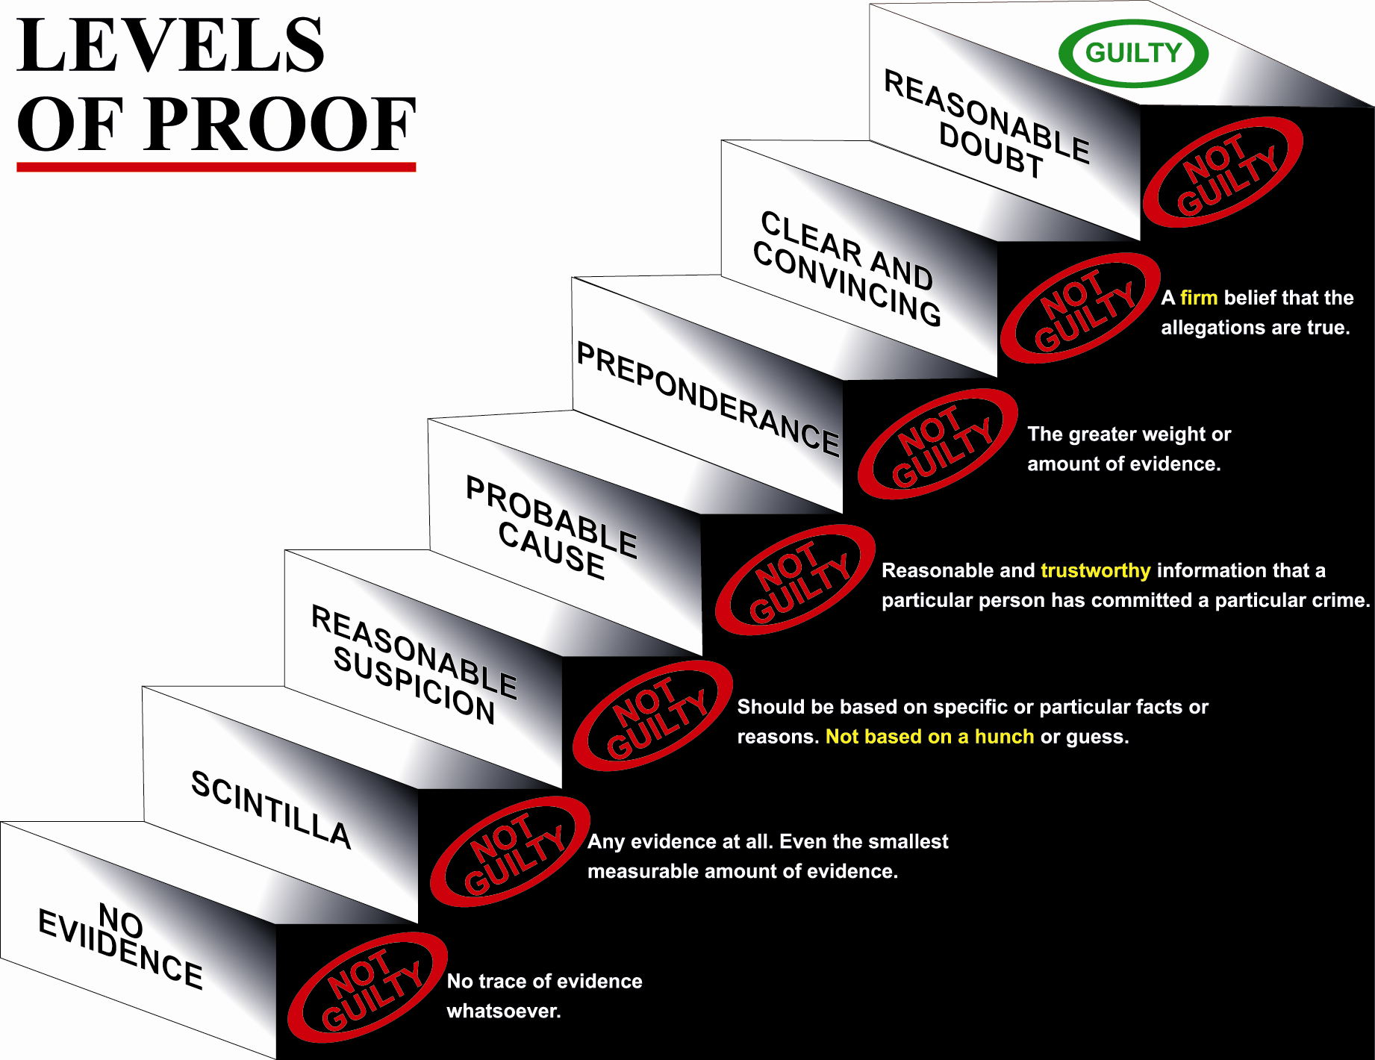

Slide 44
Second Rule of Trial
Proof Beyond and to the Exclusion of All Reasonable Doubt
If the State only proves that there was probable cause (maybe) of DWI, the verdict must be ________?

Slide 45
Second Rule of Trial
Proof Beyond and to the Exclusion of All Reasonable Doubt
If the State only proves that there was probable cause (maybe) of DWI, the verdict must be NOT GUILTY.

Slide 46
Second Rule of Trial
Proof Beyond and to the Exclusion of All Reasonable Doubt
If the State only proves that there was probable cause (maybe) of DWI, the verdict must be NOT GUILTY.
If the State only proves DWI to a preponderance of the evidence (greater weight of the evidence – more than 50 percent), the verdict must be ___________?

Slide 47
Second Rule of Trial
Proof Beyond and to the Exclusion of All Reasonable Doubt
If the State only proves that there was probable cause (maybe) of DWI, the verdict must be NOT GUILTY.
If the State only proves DWI to a preponderance of the evidence (greater weight of the evidence – more than 50 percent), the verdict must be NOT GUILTY.

Slide 48
Second Rule of Trial
Proof Beyond and to the Exclusion of All Reasonable Doubt
If the State only proves that there was probable cause (maybe) of DWI, the verdict must be NOT GUILTY.
If the State only proves DWI to a preponderance of the evidence (greater weight of the evidence – more than 50 percent), the verdict must be NOT GUILTY.
If the State only proves DWI by clear and convincing evidence (where you have a firm belief that the allegations are true), the verdict must be ________?

Slide 49
Second Rule of Trial
Proof Beyond and to the Exclusion of All Reasonable Doubt
If the State only proves that there was probable cause (maybe) of DWI, the verdict must be NOT GUILTY.
If the State only proves DWI to a preponderance of the evidence (greater weight of the evidence – more than 50 percent), the verdict must be NOT GUILTY.
If the State only proves DWI by clear and convincing evidence (where you have a firm belief that the allegations are true), the verdict must be NOT GUILTY.

Slide 50
Second Rule of Trial
Proof Beyond and to the Exclusion of All Reasonable Doubt
If the State only proves that there was probable cause (maybe) of DWI, the verdict must be NOT GUILTY.
If the State only proves DWI to a preponderance of the evidence (greater weight of the evidence – more than 50 percent), the verdict must be NOT GUILTY.
If the State only proves DWI by clear and convincing evidence (where you have a firm belief that the allegations are true), the verdict must be NOT GUILTY.
If after hearing the evidence, you are just not sure if the State has proved guilt beyond and to the exclusion of all reasonable doubt (you just do not know one way or the other), the verdict must be ______?

Slide 51
Second Rule of Trial
Proof Beyond and to the Exclusion of All Reasonable Doubt
If the State only proves that there was probable cause (maybe) of DWI, the verdict must be NOT GUILTY.
If the State only proves DWI to a preponderance of the evidence (greater weight of the evidence – more than 50 percent), the verdict must be NOT GUILTY.
If the State only proves DWI by clear and convincing evidence (where you have a firm belief that the allegations are true), the verdict must be NOT GUILTY.
If after hearing the evidence, you are just not sure if the State has proved guilt beyond and to the exclusion of all reasonable doubt (you just do not know one way or the other), the verdict must be NOT GUILTY.

Slide 52
The Law
“Not Guilty” if
  Not having normal faculties – you do not believe to be proven Beyond all Reasonable Doubt
“Not Guilty” if
  Blood alcohol level above .08 you do not believe to be proven Beyond all Reasonable Doubt
“Not Guilty” if
  By reason of the Introduction of Alcohol you do not believe to be proven beyond all reasonable doubt
“Not Guilty” if
  ANY of the elements alleged you do not believe to be proven Beyond all Reasonable Doubt
Notes:
Do you understand that is the law ?
Can you commit to me that ...?
Everyone seen the signs “if you drink, don’t drive”
Recognize that is NOT the law ?
Does anyone believe that the law should be that way ?

Slide 53
Second Rule of Trial
Proof Beyond and to the Exclusion of All Reasonable Doubt
Where Can Reasonable Doubt Come From?
From the evidence itself.

Slide 54
Second Rule of Trial
Proof Beyond and to the Exclusion of All Reasonable Doubt
Where Can Reasonable Doubt Come From?
From the Evidence Itself.
From the Lack of Evidence.

Slide 55
Second Rule of Trial
Proof Beyond and to the Exclusion of All Reasonable Doubt
Where Can Reasonable Doubt Come From?
From the Evidence Itself.
From the Lack of Evidence.
From Unanswered Questions that you have.

Slide 56
Second Rule of Trial
Proof Beyond and to the Exclusion of All Reasonable Doubt
Where Can Reasonable Doubt Come From?
From the Evidence Itself.
From the Lack of Evidence.
From Unanswered Questions that you have.
Inconsistencies in the Evidence.

Slide 57
Second Rule of Trial
Proof Beyond and to the Exclusion of All Reasonable Doubt
Where Can Reasonable Doubt Come From?
From the Evidence Itself.
From the Lack of Evidence.
From Unanswered Questions that you have.
Inconsistencies in the Evidence.
Credibility of the Evidence – do not believe some or all.

Slide 58
Second Rule of Trial
Proof Beyond and to the Exclusion of All Reasonable Doubt
Where Can Reasonable Doubt Come From?
From the Evidence Itself.
From the Lack of Evidence.
From Unanswered Questions that you have.
Inconsistencies in the Evidence.
Credibility of the Evidence – do not believe some or all.
Weight of the Evidence – just not enough.

Slide 59
Second Rule of Trial
Proof Beyond and to the Exclusion of All Reasonable Doubt
Where Can Reasonable Doubt Come From?
From the Evidence Itself.
From the Lack of Evidence.
From Unanswered Questions that you have.
Inconsistencies in the Evidence.
Credibility of the Evidence – do not believe some or all.
Weight of the Evidence – just not enough.
Not proven to you.

Slide 60
Second Rule of Trial
Proof Beyond and to the Exclusion of All Reasonable Doubt
Where Can Reasonable Doubt Come From?
From the Evidence Itself.
From the Lack of Evidence.
From Unanswered Questions that you have.
Inconsistencies in the Evidence.
Credibility of the Evidence – do not believe some or all.
Weight of the Evidence – just not enough.
Not proven to you.
Specific Reasonable Doubt – one or several.

Slide 61
Third Rule of Trial
Burden of Proof
The prosecution has the burden of proving the defendant guilty and it must do so by proving each and every element of the offense charged beyond a reasonable doubt and if it fails to do so, you must acquit the defendant.

Slide 62
Third Rule of Trial
Burden of Proof
Only and always on the State.

Slide 63
Third Rule of Trial
Burden of Proof
Only and always on the State.
We (the defense) never have to prove or disprove anything.

Slide 64
Third Rule of Trial
Burden of Proof
Only and always on the State.
We (the defense) never have to prove or disprove anything.
It means that the State has the Responsibility for the Evidence.

Slide 65
Third Rule of Trial
Burden of Proof
Only and always on the State.
We (the defense) never have to prove or disprove anything.
It means that the State has the Responsibility for the Evidence.
If you want more evidence, who do you hold the lack of evidence against?

Slide 66
Third Rule of Trial
Burden of Proof
Only and always on the State.
We (the defense) never have to prove or disprove anything.
It means that the State has the Responsibility for the Evidence.
If you want more evidence, who do you hold the lack of evidence against? The State because they have the Responsibility for the Evidence and the Burden of Proof.

Slide 67
Third Rule of Trial
Burden of Proof
Who is on trial here?

Slide 68
Third Rule of Trial
Burden of Proof
Who is on trial here?
John ______________ ???????

Slide 69
Third Rule of Trial
Burden of Proof
Who is on trial here?
John ______________ ???????
NO – The State, its case, and its evidence is on trial because it has the Burden of Proof.

Slide 70
Third Rule of Trial
Burden of Proof
Who is on trial here?
John ______________ ???????
NO – The State, its case, and its evidence is on trial.
The State’s evidence is what is on trial and what you have to judge.

Slide 71
Third Rule of Trial
Burden of Proof
If the State rests, and you have a reasonable doubt or are not sure if it has been proven beyond and to the exclusion of all reasonable doubt, and the defense produces no evidence, the verdict has to be ______?

Slide 72
Third Rule of Trial
Burden of Proof
If the State rests, and you have a reasonable doubt or are not sure if it has been proven beyond and to the exclusion of all reasonable doubt, and the defense produces no evidence, the verdict has to be NOT GUILTY.

Slide 73
Third Rule of Trial
Burden of Proof
Some say that if the defense produces no evidence or the Defendant does not testify, the Defendant must be guilty.

Slide 74
Third Rule of Trial
Burden of Proof
Some say that if the defense produces no evidence or the Defendant does not testify, the Defendant must be guilty.
Does anyone feel that way?

Slide 75
Third Rule of Trial
Burden of Proof
Some say that they must hear something from the defense before they could ever find the Defendant not guilty and that if they hear nothing from the defense they cannot find the Defendant not guilty.

Slide 76
Third Rule of Trial
Burden of Proof
Some say that they must hear something from the defense before they could ever find the Defendant not guilty and that if they hear nothing from the defense they cannot find the Defendant not guilty.
Does anyone feel that way?

Slide 77
DEFENDANT’S RIGHT NOT TO TESTIFY
Our law provides that a defendant may testify on his own behalf if he elects to do so. This however, is a right accorded a defendant, and if in the event he elects not to testify, that fact cannot be considered by you or used against him in any way.

Slide 78
Third Rule of Trial
Burden of Proof
Some say that if the Defendant does not testify, he must be guilty because anyone who is innocent would testify.

Slide 79
Third Rule of Trial
Burden of Proof
Some say that if the Defendant does not testify, he must be guilty because anyone who is innocent would testify.
Does anyone feel that way?

Slide 80
Third Rule of Trial
Burden of Proof
Some say that if the Defendant does not testify, he must be guilty because anyone who is innocent would testify.
Does anyone feel that way?
What are innocent reasons for a Defendant not to testify?

Slide 81
Third Rule of Trial
Burden of Proof
Some say that if the Defendant does not testify, he must be guilty because anyone who is innocent would testify.
Does anyone feel that way?
What are innocent reasons for a Defendant not to testify?
Lawyer says not necessary.

Slide 82
Third Rule of Trial
Burden of Proof
Some say that if the Defendant does not testify, he must be guilty because anyone who is innocent would testify.
Does anyone feel that way?
What are innocent reasons for a Defendant not to testify?
Lawyer says not necessary
State has not proven guilt – no need.

Slide 83
Third Rule of Trial
Burden of Proof
Some say that if the Defendant does not testify, he must be guilty because anyone who is innocent would testify.
Does anyone feel that way?
What are innocent reasons for a Defendant not to testify?
Lawyer says not necessary
State has not proven guilt – no need.
Fear – Nervousness – Do not speak well – Anxiety.

Slide 84
Decision Not to Take a
Breath-Blood Test or Do Exercises
Is it legal or illegal to decline to take a breath or blood test or to decline to do police exercises?

Slide 85
Decision Not to Take a
Breath-Blood Test or Do Exercises
Is it legal or illegal to decline to take a breath or blood test or to decline to do police exercises?
The law gives every person the option to decline to take a breath or blood test and requires that if a person declines none shall be taken unless the police get a search warrant.
No one has any legal obligation to do the police exercises. It is perfectly legal to just say no.

Slide 86
Decision Not to Take a
Breath Test or Do Exercises
Is it legal or illegal to decline to take a breath or blood test or to decline to do police exercises.?
The law gives every person the option to decline to take a breath or blood test and requires that if a person declines none shall be taken unless the police get a search warrant.
No one has any legal obligation to do the police exercises. It is perfectly legal to just say no.
Anyone fundamentally disagree with that law?

Slide 87
Decision Not to Take a
Breath Test or Do Exercises
Is it legal or illegal to decline to take a breath test or to decline to do police exercises.?
The law gives every person the option to decline to take a breath test and requires that if a person declines none shall be taken unless the police get a search warrant. No one has any legal obligation to do the police exercises. It is perfectly legal to just say no.
Anyone fundamentally disagree with that law?
Anyone believe that a person who does so is likely guilty because of their decision not to cooperate?

Slide 88
Decision not to Cooperate with Police
Who is the American “reasonable person” when it comes to police interactions?

Slide 89
Decision not to Cooperate with Police
Who is the American “reasonable person” when it comes to police interactions?
He is someone who knows his rights and feels free to exercise them.

Slide 90
Decision not to Cooperate with Police
Who is the American “reasonable person” when it comes to police interactions?
He is someone who knows his rights and feels free to exercise them.
He is not intimidated by the police, whether they are alone or in a group, in uniform or in plain clothes.

Slide 91
Decision not to Cooperate with Police
Who is the American “reasonable person” when it comes to police interactions?
He is someone who knows his rights and feels free to exercise them.
He is not intimidated by the police, whether they are alone or in a group, in uniform or in plain clothes.
He knows that when questioned, he can refuse to answer . . . .

Slide 92
Decision not to Cooperate with Police
Who is the American “reasonable person” when it comes to police interactions?
He is someone who knows his rights and feels free to exercise them.
He is not intimidated by the police, whether they are alone or in a group, in uniform or in plain clothes.
He knows that when questioned, he can refuse to answer.
He always feels free to end the encounter even if physically constrained by his surroundings and even if the police persist in their attempts to engage him in conversation.

Slide 93
Decision not to Cooperate with Police
Who is the American “reasonable person” when it comes to police interactions?
He is someone who knows his rights and feels free to exercise them.
He is not intimidated by the police, whether they are alone or in a group, in uniform or in plain clothes.
He knows that when questioned, he can refuse to answer.
He always feels free to end the encounter even if physically constrained by his surroundings and even if the police persist in their attempts to engage him in conversation.
He rests secure in the knowledge that no physical harm will result and that the police cannot legally draw an inference of criminality from his refusal to cooperate.

Slide 94
Decision not to Cooperate with Police
Who is the American “reasonable person” when it comes to police interactions?
He is someone who knows his rights and feels free to exercise them.
He is not intimidated by the police, whether they are alone or in a group, in uniform or in plain clothes.
He knows that when questioned, he can refuse to answer.
He always feels free to end the encounter even if physically constrained by his surroundings and even if the police persist in their attempts to engage him in conversation.
He rests secure in the knowledge that no physical harm will result and that the police cannot legally draw an inference of criminality from his refusal to cooperate.
In short, he regards an encounter with police as no different from one with a panhandler on the street, a religious proselytizer at his doorstep, or a Hare Krishna in the airport."

Slide 95
Decision not to Cooperate with Police
Who is the American “reasonable person” when it comes to police interactions?
He is someone who knows his rights and feels free to exercise them.
He is not intimidated by the police, whether they are alone or in a group, in uniform or in plain clothes.
He knows that when questioned, he can refuse to answer.
He always feels free to end the encounter even if physically constrained by his surroundings and even if the police persist in their attempts to engage him in conversation.
He rests secure in the knowledge that no physical harm will result and that the police cannot legally draw an inference of criminality from his refusal to cooperate.
In short, he regards an encounter with police as no different from one with a panhandler on the street, a religious proselytizer at his doorstep, or a Hare Krishna in the airport.”
Texas Court of Criminal Appeals, September 11, 2013 – Wade v. State.

Slide 96
Intaxilyzer 5000
A machine brought to you by the government.
Insert your tax return, it will read it and then decide whether you have committed tax fraud. If it says you have, you go to jail.
You must just trust it and the government.

Slide 97
Intaxilyzer 5000
A machine brought to you by the government.
Insert your tax return, it will read it and then decide whether you have committed tax fraud. If it says you have, you go to jail.
You must just trust it and the government.
They ask you to do it – would you?

Slide 98
Intaxilyzer 5000
A machine brought to you by the government.
Insert your tax return, it will read it and then decide whether you have committed tax fraud. If it says you have, you go to jail.
It will destroy (not keep) what you insert into it. You must just trust it and the government.
You also have the choice to have a committee of six look at your return and decide whether you have committed tax fraud.

Slide 99
Intaxilyzer 5000
A machine brought to you by the government.
Insert your tax return, it will read it and then decide whether you have committed tax fraud. If it says you have, you go to jail.
You must just trust it and the government.
You also have the choice to have a committee of six look at your return (and they will not destroy it) and decide whether you have committed tax fraud.
What would you choose – the committee of six or the machine?

Slide 100
Intaxilyzer 5000
What if this great government machine spit out a report that said you owed one million dollars in taxes – even though you only had $50,000 in income – and that because you only paid $15,000 in taxes (instead of one million) you were guilty of fraud and were going to jail?

Slide 101
Intaxilyzer 5000
What if this great government machine spit out a report that said you owed one million dollars in taxes – even though you only had $50,000 in income – and that because you only paid $15,000 in taxes (instead of one million) you were guilty of fraud and were going to jail?
Would you believe and trust the machine when your W-2 and other papers were inconsistent with it?

Slide 102
Intaxilyzer 5000
What if this great government machine spit out a report that said you owed one million dollars in taxes – even though you only had $50,000 in income – and that because you only paid $15,000 in taxes (instead of one million) you were guilty of fraud and were going to jail?
Would you believe and trust the machine when your W-2 and other papers were inconsistent with it?
Who should have to prove the information you gave them was wrong?

Slide 103
Machines v. Common Sense
Consider a possibly sick child with a possible temperature – you take her to the doctor and they take her temperature with a fancy electronic thermometer.

Slide 104
Machines v. Common Sense
Consider a possibly sick child with a possible temperature – you take her to the doctor and they take her temperature with a fancy electronic thermometer.
The doctor uses it so it must be good. Does that mean it is good and always works?

Slide 105
Machines v. Common Sense
Consider a possibly sick child with a possible temperature – you take her to the doctor and they take her temperature with a fancy electronic thermometer.
The doctor uses it so it must be good. Does that mean it is good and always works?
It reports that your child’s temperature is 110 degrees.

Slide 106
Machines v. Common Sense
Consider a possibly sick child with a possible temperature – you take her to the doctor and they take her temperature with a fancy electronic thermometer.
The doctor uses it so it must be good. Does that mean it is good and always works?
It reports that your child’s temperature is 110 degrees.
What does that tell you? It must be wrong?
Why – how do you know? Common sense?

Slide 107
Machines v. Common Sense
Consider a possibly sick child with a possible temperature – you take her to the doctor and they take her temperature with a fancy electronic thermometer.
The doctor uses it so it must be good. Does that mean it is good and always works?
It reports that your child’s temperature is 110 degrees.
What does that tell you? It must be wrong.
Why – how do you know? Common sense.
Do you need to know why it is wrong or by how much, to know it is just wrong?

Slide 108
Machines v. Common Sense
Consider a possibly sick child with a possible temperature –you take her to the doctor and they take her temperature with a fancy electronic thermometer.
The doctor uses it so it must be good. Does that mean it is good and always works?
It reports that your child’s temperature is 110 degrees.
What does that tell you? It must be wrong.
Why – how do you know? Common sense.
Do you need to know why it is wrong or by how much, to know it is just wrong?
Would you trust a machine when your common sense tells you it must be wrong?

Slide 109
Machines v. Common Sense
Consider a possibly sick child with a possible temperature – you take her to the doctor and they take her temperature with a fancy electronic thermometer.
The doctor uses it so it must be good. Does that mean it is good and always works?
It reports that your child’s temperature is 110 degrees.
What does that tell you? It must be wrong.
Why – how do you know? Common sense.
Do you need to know why it is wrong or by how much, to know it is just wrong?
Would you trust a machine when your common sense tells you it must be wrong?
As a juror, you get to decide whether and what to believe. You can believe all, none, or some. You can conclude that some piece of evidence is just not good enough to rely on.

Slide 110
Mental and Physical Faculties
"Intoxicated" means:
(A) not having the normal use of mental or physical faculties by reason of the introduction of alcohol . . . into the body; or
(B) having an alcohol concentration of 0.08 or more.

Slide 111
Mental and Physical Faculties
Are all persons faculties the same?

Slide 112
Mental and Physical Faculties
Are all persons faculties the same?
Are all people’s faculties the same as an average person?

Slide 113
Mental and Physical Faculties
Are all persons faculties the same?
Are all people’s faculties the same as an average person?
Are your normal faculties always at the same level all of the time or are they in a range?

Slide 114
Mental and Physical Faculties
Are all persons faculties the same?
Are all people’s faculties the same as an average person?
Are your normal faculties always at the same level all of the time or are they in a range?
What affects the range?

Slide 115
Mental and Physical Faculties
Are all persons faculties the same?
Are all people’s faculties the same as an average person?
Are your normal faculties always at the same level all of the time or are they in a range?
What effects the range?
Time of day – Coordination – Physical Condition – Fatigue – Tired – Nervousness – Stress – Fear – Distrust – Surprise -- Anxiety

Slide 116
Mental and Physical Faculties
Are all persons faculties the same?
Are all people’s faculties the same as an average person?
Are your normal faculties always at the same level all of the time or are they in a range?
What effects the range?
Time of day – Coordination – Physical Condition – Fatigue – Tired – Nervousness – Stress – Fear – Distrust – Surprise – Anxiety
To know if a person does not have normal mental or physical faculties because of alcohol or for some other innocent reason, do you need to know what is usual (normal) for that person?

Slide 117
Mental and Physical Faculties
Are all persons faculties the same?
Are all people’s faculties the same as an average person?
Are your normal faculties always at the same level all of the time or are they in a range?
What effects the range?
Time of day – Coordination – Physical Condition – Fatigue – Tired – Nervousness – Stress – Fear – Distrust – Surprise – Anxiety
To know if a person does not have normal mental or physical faculties because of alcohol or for some other innocent reason, do you need to know what is usual (normal) for that person?
Who would I ask to know what is usual (normal) for you?

Slide 118
Mental and Physical Faculties
Why do we not require physical and mental tests to get a driver’s license?

Slide 119
Mental and Physical Faculties
If we want to a test to tell us whether someone does not have normal faculties, should we test things that people normally do or things they do not normally do?

Slide 120
Mental and Physical Faculties
If we want to a test to tell us whether someone does not have normal faculties, should we test things that people normally do or things they do not normally do?
What are some innocent reasons why someone may not look good on police tests but not be intoxicated?

Slide 121
Mental and Physical Faculties
If we want to a test to tell us whether someone does not have normal faculties, should we test things that people normally do or things they do not normally do?
What are some innocent reasons why someone may not look good on police tests but not be intoxicated?
Time of day – Coordination – Physical Condition – Fatigue – Tired – Nervousness – Stress – Fear – Distrust – Surprise – Anxiety

Slide 122
Police Officer
Witnesses

Slide 123
Police Officer Witnesses
Would you tend to believe a police officer over someone else just because they are a police officer?

Slide 124
Police Officer Witnesses
Would you tend to believe a police officer over someone else just because they are a police officer?
Are police officers more believable than other people?

Slide 125
Police Officer Witnesses
Would you tend to believe a police officer over someone else just because they are a police officer?
Are police officers more believable than other people?
Some people say that even before a police officer testified, they would already lean towards believing what the police officer was going to say. Do you feel that way?

Slide 126
Questions – Rate 1 to 5
1 Strongly Agree - 2 Agree -3 No opinion
4 Disagree - 5 Strongly Disagree
Anyone who drinks and drives is guilty of DWI.

Slide 127
Questions – Rate 1 to 5
1 Strongly Agree - 2 Agree -3 No opinion
4 Disagree - 5 Strongly Disagree
Anyone who drinks and drives is guilty of DWI.
Police only arrest people for DWI if the person is guilty of DWI?

Slide 128
Questions – Rate 1 to 5
1 Strongly Agree - 2 Agree -3 No opinion
4 Disagree - 5 Strongly Disagree
Anyone who drinks and drives is guilty of DWI.
Police only arrest people for DWI if the person is guilty of DWI?
Anyone who declines to cooperate with the police investigating them for a suspected DWI is likely guilty of DWI?

Slide 129
Group Decision
Assume 10 people are charged with a crime. Also assume that you know that nine are absolutely guilty and that one is absolutely innocent.
However, you must decide whether to convict all 10 or find all 10 not guilty.
If you convict all 10, then one innocent person gets convicted. If you acquit all ten, then nine guilty people go free.

Slide 130
Group Decision
Assume 10 people are charged with a crime. Also assume that you know that nine are absolutely guilty and that one is absolutely innocent.
However, you must decide whether to convict all 10 or find all 10 not guilty.
If you convict all 10, then one innocent person gets convicted. If you acquit all ten, then nine guilty people go free.
What is your decision? Convict or Acquit the group?

Slide 131
Relationships and Groups
Do you have a close friend or relative who is in law enforcement, is a prosecutor, or is a judge?

Slide 132
Relationships and Groups
Do you have a close friend or relative who is in law enforcement, is a prosecutor, or is a judge?
Are you a member of or have you donated money to MADD or similar groups?

Slide 133
Relationships and Groups
Do you have a close friend or relative who is in law enforcement, is a prosecutor, or is a judge?
Are you a member of or have you donated money to MADD or similar groups?
Have you ever been a member of the 100 Club or donated money to Crime Stoppers?

Slide 134
Relationships and Groups
Do you have a close friend or relative who is in law enforcement, is a prosecutor, or is a judge?
Are you a member of or have you donated money to MADD or similar groups?
Have you ever been a member of the 100 Club or donated money to Crime Stoppers?
Are you a non drinker and, if so, why?

Slide 135
Relationships and Groups
Do you have a close friend or relative who is in law enforcement, is a prosecutor, or is a judge?
Are you a member of or have you donated money to MADD or similar groups?
Have you ever been a member of the 100 Club or donated money to Crime Stoppers?
Are you a non drinker?
Know any of the witnesses?

Slide 136
Relationships and Groups
Do you have a close friend or relative who is in law enforcement, is a prosecutor, or is a judge?
Are you a member of or have you donated money to MADD or similar groups?
Have you ever been a member of the 100 Club or donated money to Crime Stoppers?
Are you a non drinker?
Know any of the witnesses?
Bad experiences with Alcohol?

Slide 137
Jury Function
Some say it is acceptable to find someone charged with a crime guilty simply to send a message to that person or society.

Slide 138
Jury Function
Some say it is acceptable to find someone charged with a crime guilty simply to send a message to that person or society.
Does anyone feel that way?

Slide 139
Jury Function
Some say it is acceptable to find someone charged with a crime guilty simply to send a message to that person or society.
Does anyone feel that way?
Others say that it is only acceptable to find someone guilty if the State has proven them guilty beyond and to the exclusion of all reasonable doubt.

Slide 140
Jury Function
Some say it is acceptable to find someone charged with a crime guilty simply to send a message to that person or society.
Does anyone feel that way?
Others say that it is only acceptable to find someone guilty if the State has proven them guilty beyond and to the exclusion of all reasonable doubt.
Is sending a message ever a reason to find someone guilty?

Slide 141
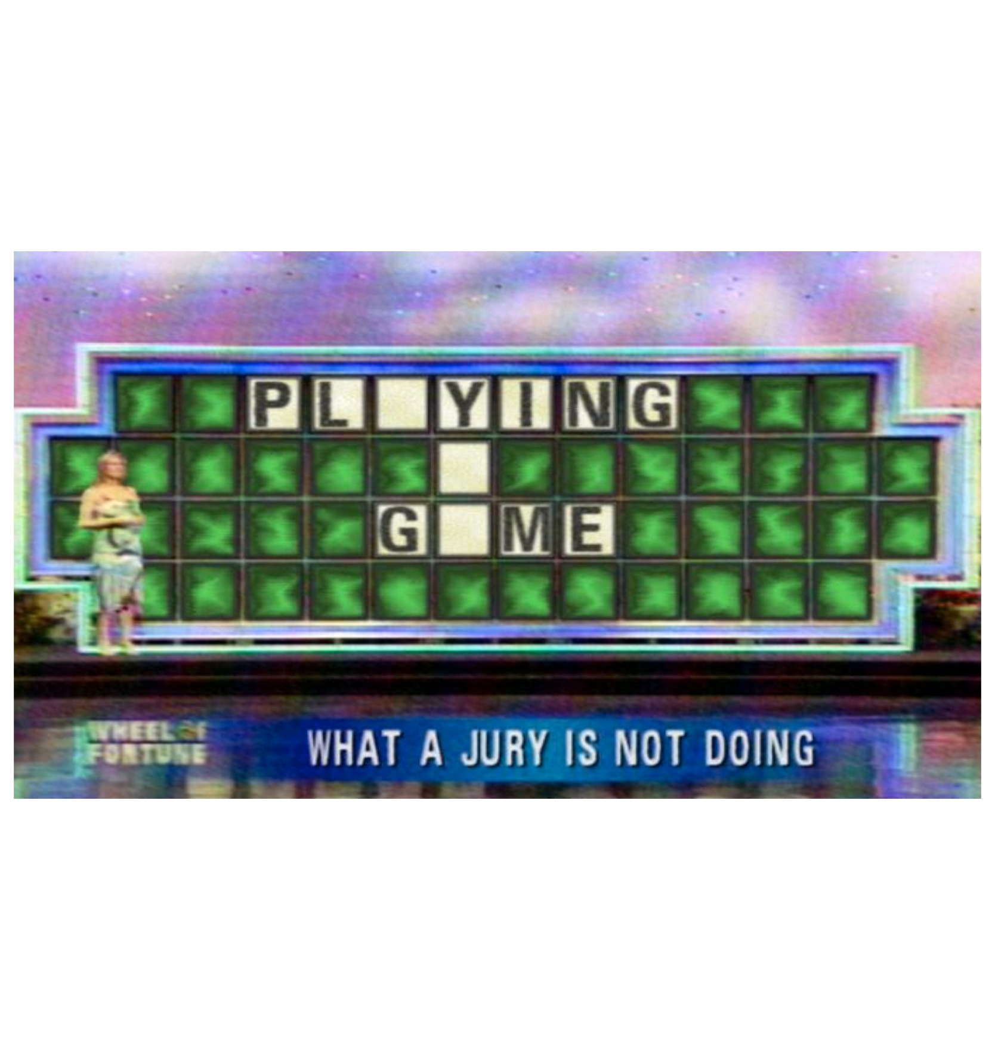

Slide 142
Decision Making
6 Jurors means 6 verdicts.
Each person has the right to their own verdict.
If all six agree, then there is a group verdict.
If all six do not agree then there is not a group verdict. This is acceptable.
Why do we choose six or twelve people to be on a jury? Why not just one?

Slide 143
Decision Making
6 Jurors means 6 verdicts.
Each person has the right to their own verdict.
If all six agree, then there is a group verdict.
If all six do not agree then there is not a group verdict. This is acceptable.
Some people stick to their beliefs and others go along to get along with the group.
Which kind of person are you?

Slide 144
Decision Making
6 Jurors means 6 verdicts.
Each person has the right to their own verdict.
If all six agree, then there is a group verdict.
If all six do not agree then there is not a group verdict. This is acceptable.
Some people stick to their beliefs and others go along to get along with the group.
Which kind of person are you?
Some people give up their beliefs just to be done. Would you ever do that?

Slide 145
Last Two Questions
Is there anyone who has anything that you want or need to talk to us privately about?

Slide 146
Last Two Questions
Is there anyone who has anything that you want or need to talk to us privately about?
Is there anything else about you we should know? If we just asked the right question, we would learn something important that you would want to know if you were us.

