Slide 1
Reframing Defensive Theories in Voir Dire
MCDAA
May 2025
W. Troy McKinney
Schneider & McKinney, P.C.
5300 Memorial Dr, Ste 750
Houston, TX 77007
713-951-9994
wtmhousto2@aol.com
Noemi5901@aol.com
`

Slide 2
Defensive Theories
Most DWI cases are only about reasonable doubt.
We cannot and should not seek to prove innocence. It is a fool’s errand.

Slide 3
Goals of Voir Dire
Identify the bad Jurors.
Not identify the good jurors.
Begin to inform and educate the jury about our theory of the case.
This means you must have a theory of the case.

Slide 4
Framing – Theory – Theme
Frame things the way that it advances your theory.
Framing is how you want the jury to view the case and evidence.
Do not let the State frame the discussion.
Your theory is what the case is about.
Find your trilogy. This case is about 1,2 and 3.

Slide 5
Theory of the Case
Most DWI Cases are Reasonable Doubt Cases
This case is about assumptions, mistakes, and a rush to judgment.

Slide 6
Theory of the Case
Most DWI Cases are Reasonable Doubt Cases
This case is about assumptions, mistakes, and a rush to judgment.
This case is about preconceived beliefs, finding what they were looking for, and ignoring everything to the contrary. (tunnel vision)

Slide 7
Theory of the Case
Most DWI Cases are Reasonable Doubt Cases
This case is about assumptions, mistakes, and a rush to judgment.
This case is about preconceived beliefs, finding what they were looking for, and ignoring everything to the contrary. (tunnel vision)
This case is about the failure to meaningfully investigate, the failure to preserve evidence, and unfounded opinions.

Slide 8
Theory of the Case
Most DWI Cases are Reasonable Doubt Cases
This case is about assumptions, mistakes, and a rush to judgment.
This case is about preconceived beliefs, finding what they were looking for, and ignoring everything to the contrary. (tunnel vision)
This case is about the failure to meaningfully investigate, the failure to preserve evidence, and unfounded opinions.
This case is about exaggerations, sloppiness, and baseless conclusions.

Slide 9
Theory of the Case
Most DWI Cases are Reasonable Doubt Cases
This case is about assumptions, mistakes, and a rush to judgment.
This case is about preconceived beliefs, finding what they were looking for, and ignoring everything to the contrary. (tunnel vision)
This case is about the failure to meaningfully investigate, the failure to preserve evidence, and unfounded opinions.
This case is about exaggerations, sloppiness, and baseless conclusions.
This case is about mere opinions, not facts, beliefs, not evidence, and conclusions, not reason.

Slide 10
Why We Are Here
We say – Gonzalo was not driving while intoxicated.

Slide 11
Why We Are Here
We say – Gonzalo was not driving while intoxicated.
They say – they think Gonzalo may have been driving while intoxicated.

Slide 12
What We Want – Good Jurors
Not all people are good jurors for all kinds of cases.

Slide 13
What We Want – Good Jurors
Not all people are good jurors for all kinds of cases.
We want people who want to be as good a juror as I want to be a lawyer.

Slide 14
What We Want – Good Jurors
Not all people are good jurors for all kinds of cases.
We want people who want to be as good a juror as I want to be a lawyer.
Thoughtful, attentive, inquisitive, questioning, and open-minded.

Slide 15
What We Want – Good Jurors
Not all people are good jurors for all kinds of cases.
We want people who want to be as good a juror as I want to be a lawyer.
Thoughtful, attentive, inquisitive, questioning, and open-minded.
Jurors who will follow the law – not all can, will, or want to – and that is okay. Just tell us your honest opinions and beliefs. Everyone will respect you for your honesty.

Slide 16
What We Want – Good Jurors
Not all people are good jurors for all kinds of cases.
We want people who want to be as good a juror as I want to be a lawyer.
Thoughtful, attentive, inquisitive, questioning, and open-minded.
Jurors who will follow the law – not all can, will, or want to – and that is okay. Just tell us your honest opinions and beliefs. Everyone will respect you for your honesty.
Most importantly: BE HONEST. Your oath requires you to tell us you disagree with us if you do. Just be honest: I promise we will respect your honesty.

Slide 17
Three Rules of Trial
To Prevent Wrongful Convictions
To Protect the Innocent
Presumption of Innocence.
Level of Proof – Beyond and to the exclusion of all reasonable doubt.
Burden of Proof – Responsibility for the evidence is always and only on the State.

Slide 18
Presumption of Innocence
What is a presumption?

Slide 19
Presumption of Innocence
What is a presumption?
Assumption
Favoritism
Leaning
Prejudgment
Strongly Held Belief
Must be True – a State of Mind
Bias – in favor of or against one side.

Slide 20
Presumption of Innocence
Examples of Common Presumptions
Lightening and Thunder….presume ______?

Slide 21
Presumption of Innocence
Examples of Common Presumptions
Lightening and Thunder….presume a storm.

Slide 22
Presumption of Innocence
Examples of Common Presumptions
Lightening and Thunder….presume a storm.
Dark clouds and wet ground…presume _____?

Slide 23
Presumption of Innocence
Examples of Common Presumptions
Lightening and Thunder….presume a storm.
Dark clouds and wet ground…presume it rained.

Slide 24
Presumption of Innocence
Examples of Common Presumptions
Lightening and Thunder….presume a storm.
Dark clouds and wet ground…presume it rained.
Person in handcuffs on TV….presume ______?

Slide 25
Presumption of Innocence
Examples of Common Presumptions
Lightening and Thunder….presume a storm.
Dark clouds and wet ground…presume it rained.
Person in handcuffs on TV….presume innocence?

Slide 26
Presumption of Innocence
Examples of Common Presumptions
Lightening and Thunder….presume a storm.
Dark clouds and wet ground…presume it rained.
Person in handcuffs on TV….presume innocence?
Person on the side of the road pulled over by police…presume ________?

Slide 27
Presumption of Innocence
Examples of Common Presumptions
Lightening and Thunder….presume a storm.
Dark clouds and wet ground…presume it rained.
Person in handcuffs on TV….presume innocence?
Person on the side of the road pulled over by police…presume innocent and done nothing illegal?

Slide 28
Is a Presumption a Bias?
If the person next to you told you that they presumed that you were a racist, would you believe that they were biased against you?

Slide 29
Linking Presumption to Bias
If the person next to you told you that they presumed that you were a racist, would you believe that they were biased against you?
If I told you that the person next to you would always be honest and never lie about anything because they look nice, would you believe that I was biased in favor of them?

Slide 30
Presumption of Innocence
Because a presumption is a bias . . . .
If there was a presumption of guilt (and there is not), you would have to be biased in favor of ________?

Slide 31
Presumption of Innocence
Because a presumption is a bias . . . .
If there was a presumption of guilt (and there is not), you would have to be biased in favor of the State?

Slide 32
Presumption of Innocence
Because a presumption is a bias . . . .
If there was a presumption of guilt (and there is not), you would have to be biased in favor of the State?
Because there is a presumption of innocence, the law requires you to be biased in favor of ________?

Slide 33
Presumption of Innocence
Because a presumption is a bias . . . .
If there was a presumption of guilt (and there is not), you would have to be biased in favor of the State?
Because there is a presumption of innocence, the law requires you to be biased in favor of Gonzalo?

Slide 34
Presumption of Innocence
Because a presumption is a bias . . . .
If there was a presumption of guilt (and there is not), you would have to be biased in favor of the State?
Because there is a presumption of innocence, the law requires you to be biased in favor of Gonzalo?
To be fair and follow the law (rules of trial) in this case, the law requires that you must be biased in favor of Gonzalo.

Slide 35
Presumption of Innocence
Who will not or cannot be biased in favor of (have a strongly held belief in favor of) Gonzalo’s innocence?

Slide 36
Presumption of Innocence
Who will not or cannot be biased in favor of (have a strongly held belief in favor of) Gonzalo’s innocence?
Who will be biased in favor of Gonzalo’s innocence?

Slide 37
Presumption of Innocence
Real Beliefs v. Theory
Not everyone can, will, or wants to really presume someone innocent – because they do not honestly (or really) believe it.

Slide 38
Presumption of Innocence
Real Beliefs v. Theory
Not everyone can, will, or wants to really presume someone innocent – because they do not honestly (or really) believe it.
That is okay. It is normal and human.

Slide 39
Presumption of Innocence
Real Beliefs v. Theory
Despite knowing what the law requires….

Slide 40
Presumption of Innocence
Real Beliefs v. Theory
Despite knowing what the law requires….
Who believes or thinks Gonzalo must have done something illegal or he would not be here?

Slide 41
Presumption of Innocence
Real Beliefs v. Theory
Despite knowing what the law requires….
Who believes or thinks Gonzalo must have done something illegal or he would not be here?
Has Gonzalo already lost some of the presumption of innocence? Some leaning against him or for the State?

Slide 42
Presumption of Innocence
Real Beliefs v. Theory
Despite knowing what the law requires….
Who honestly still has a doubt about Gonzalo’s innocence?

Slide 43
Presumption of Innocence
Real Beliefs v. Theory
Despite knowing what the law requires….
Who still has a doubt about Gonzalo’s innocence?
Will that doubt about his innocence cause you to not fully and really presume him completely innocent?

Slide 44
Second Rule of Trial
Proof Beyond and to the Exclusion of All Reasonable Doubt

Slide 45
Second Rule of Trial
Proof Beyond and to the Exclusion of All Reasonable Doubt
What does it mean?
You get to decide – with some guidance and context, but no definition. It is what you decide it is.
You must be 100 percent free of reasonable doubt.

Slide 46
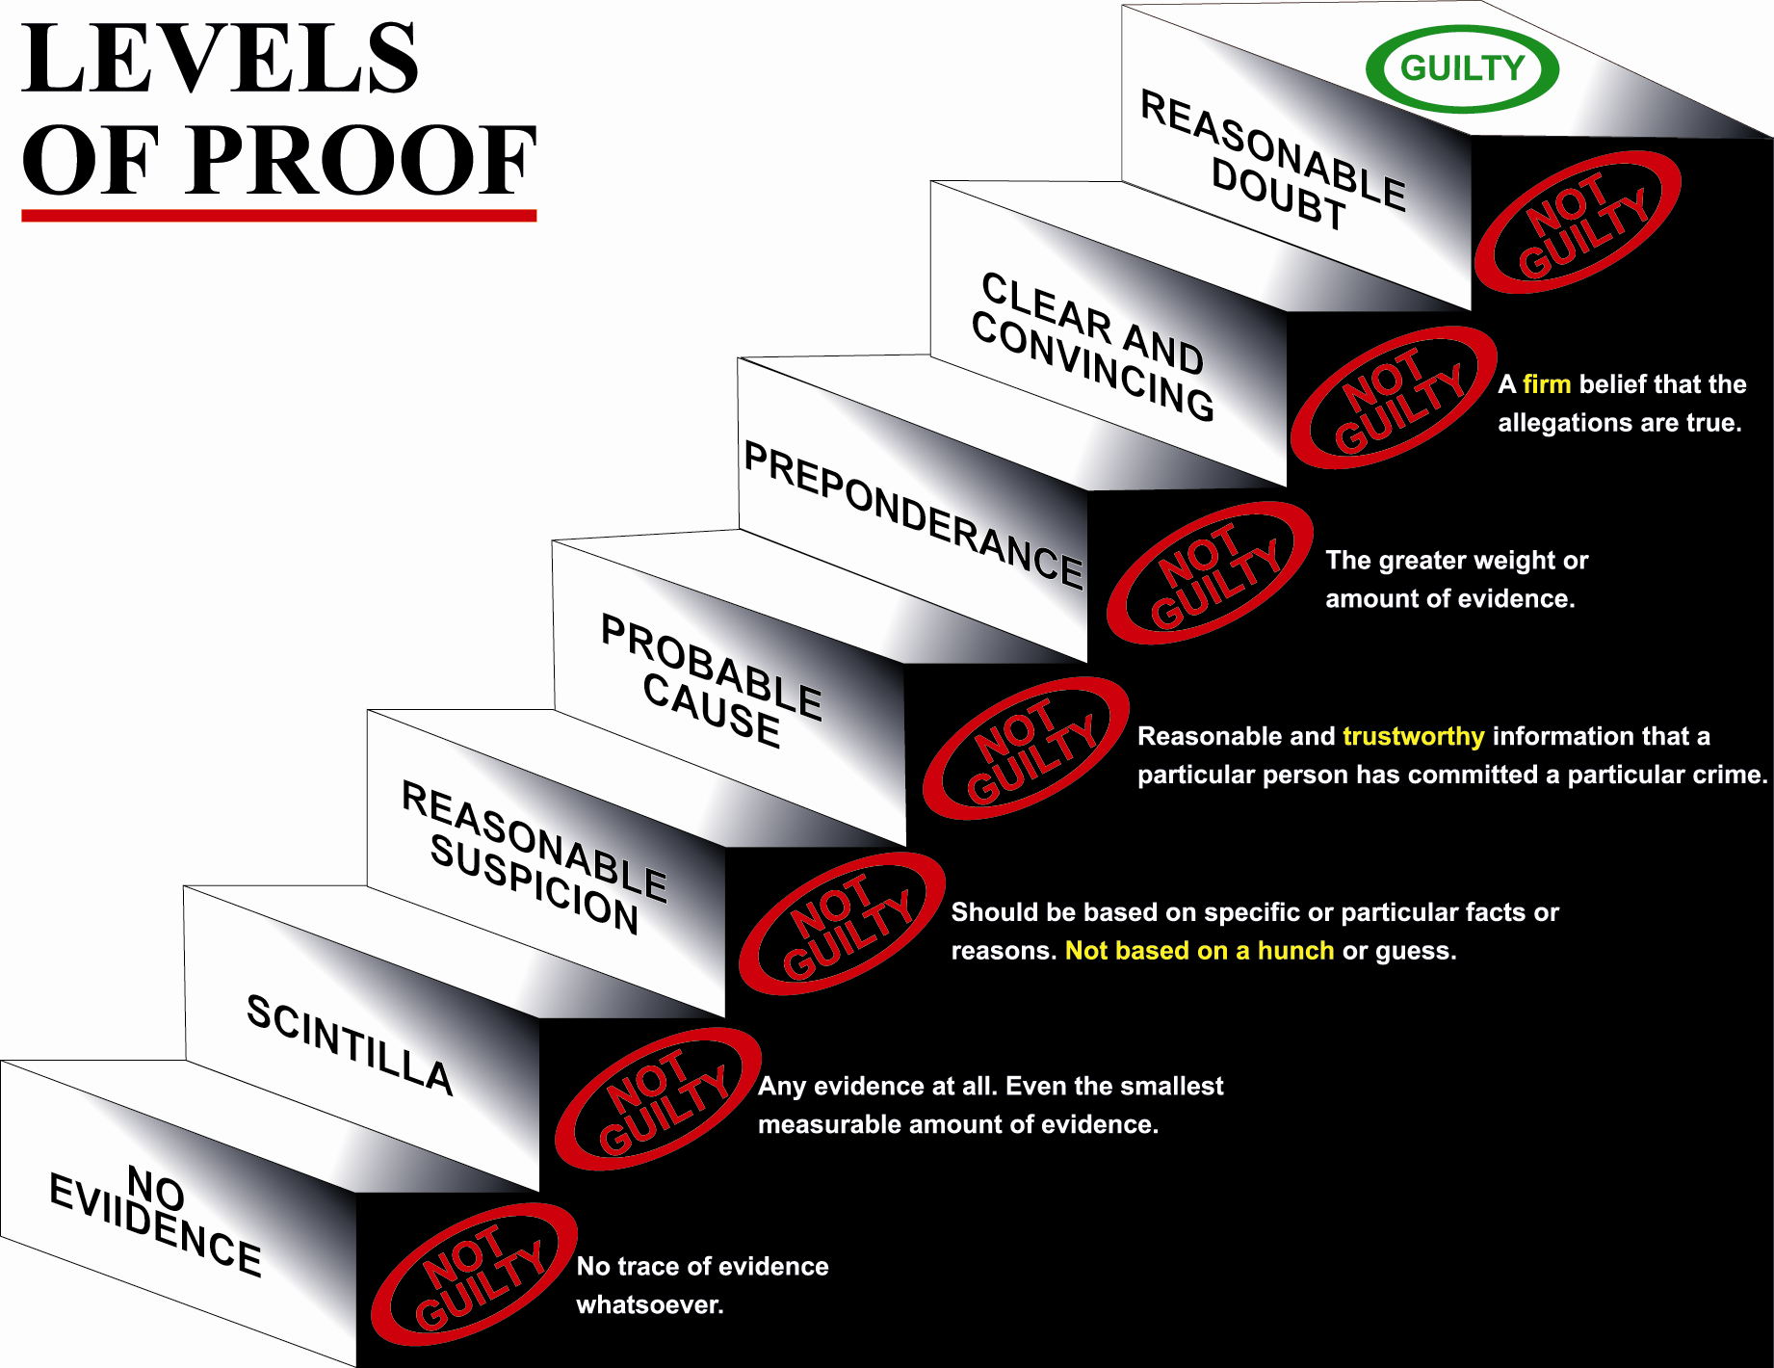

Slide 47
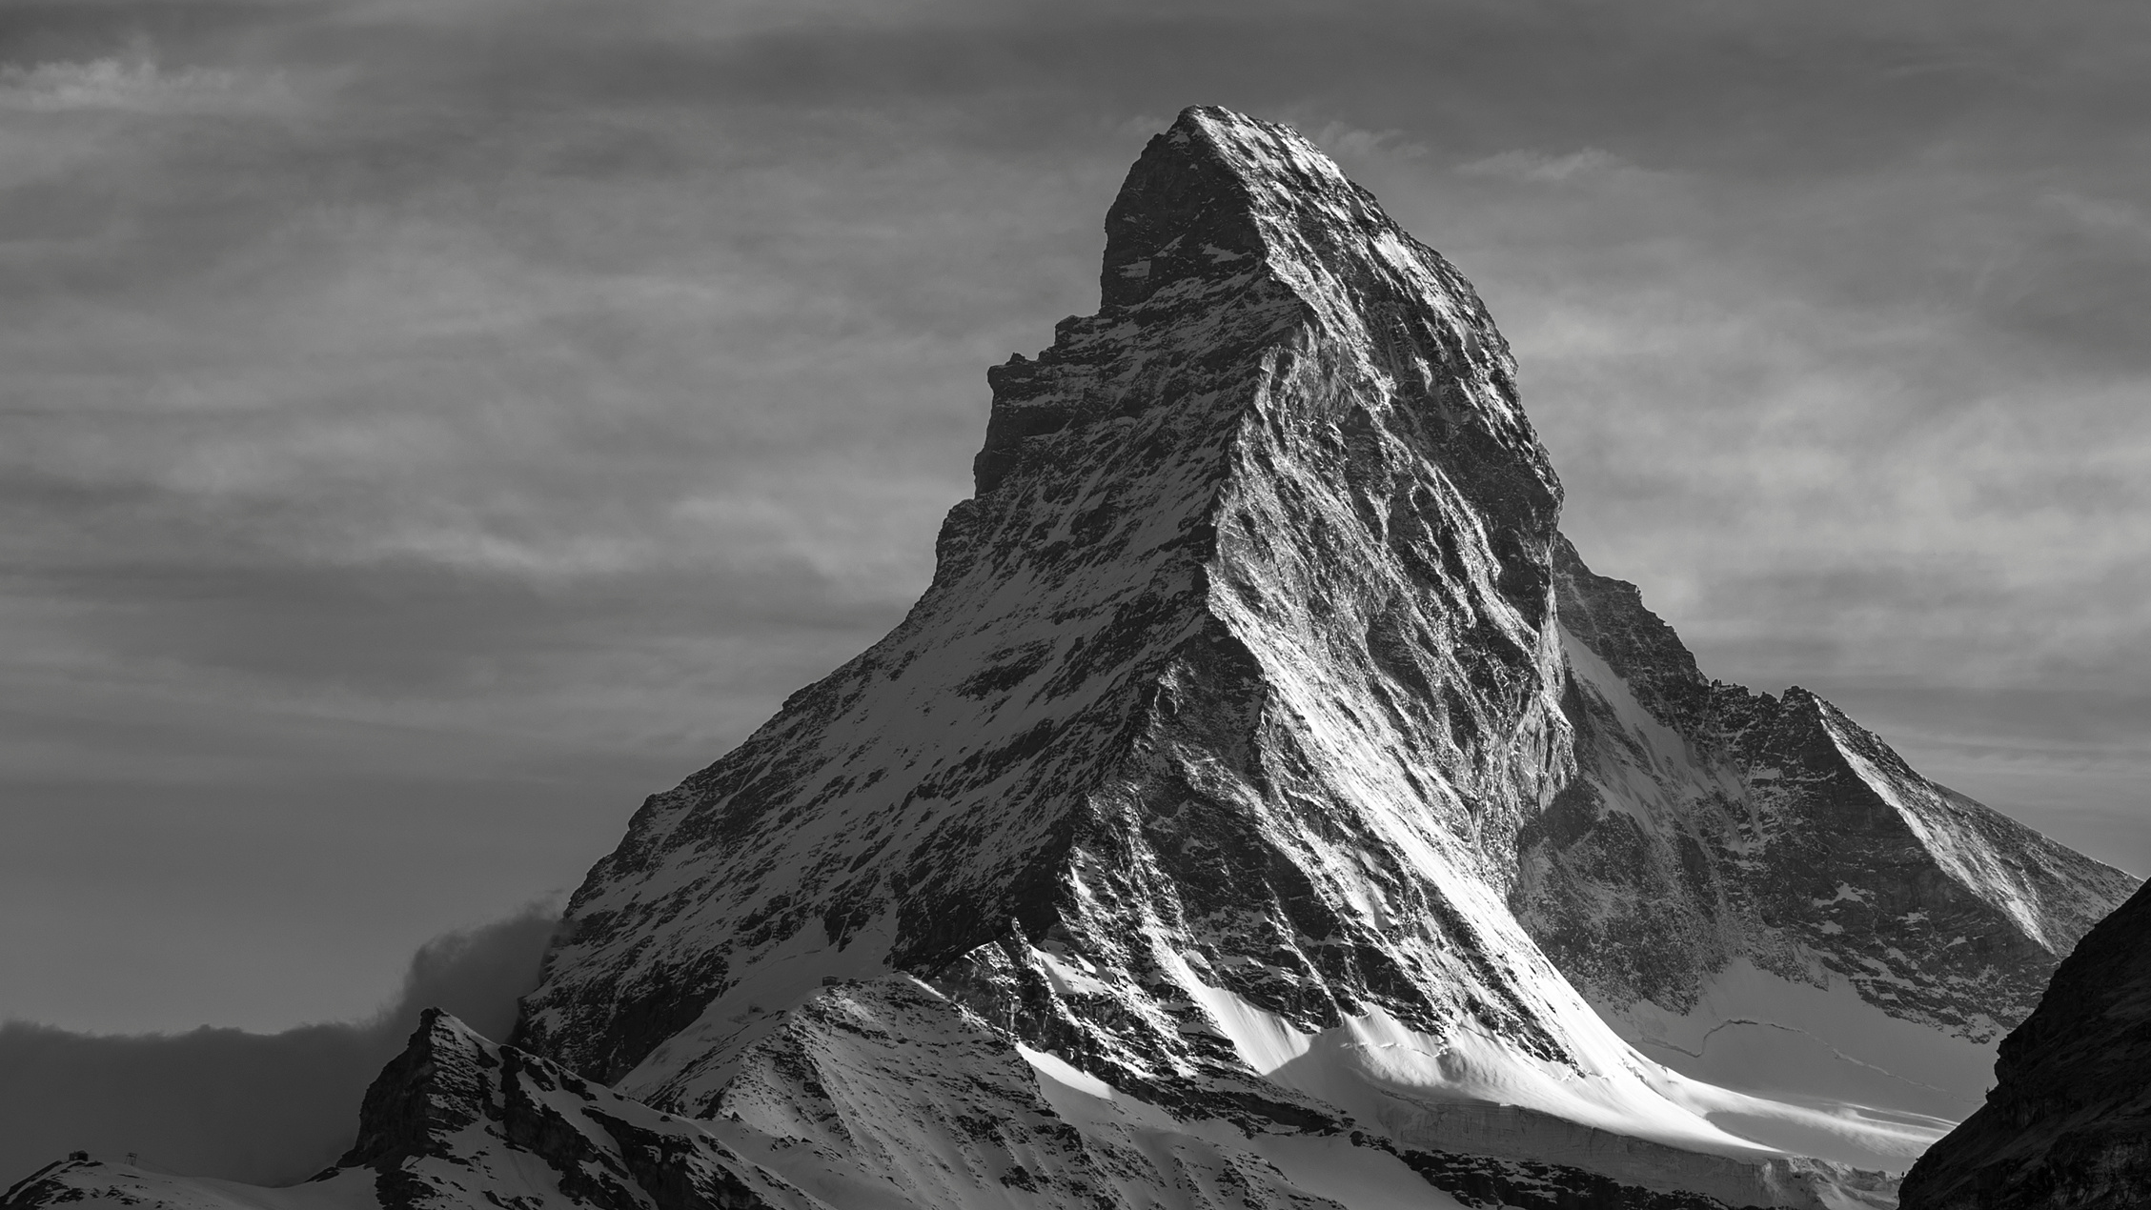
Burden of
Proof
Notes:
Next, is reasonable suspicion. This part of the mountain trek is the part the kids can make it to. You have started to make the hike, but you really haven't made it that far. It's still not too late to turn around...
In legal sense, we look at this as what an officer has to stop someone. If you are walking down the street in the middle of Texas summer with a ski mask and a trench coat, that's reasonable suspicion to stop you. However, if it is the Texas winter like we have been experiencing, its a little more justified.

Slide 48
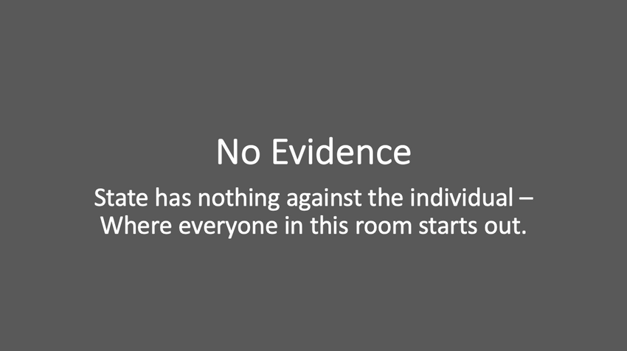
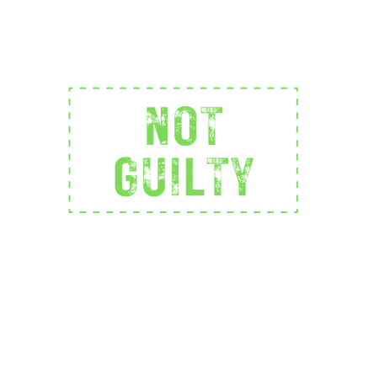

Burden of
Proof
no evidence
Notes:
Next, is reasonable suspicion. This part of the mountain trek is the part the kids can make it to. You have started to make the hike, but you really haven't made it that far. It's still not too late to turn around...
In legal sense, we look at this as what an officer has to stop someone. If you are walking down the street in the middle of Texas summer with a ski mask and a trench coat, that's reasonable suspicion to stop you. However, if it is the Texas winter like we have been experiencing, its a little more justified.

Slide 49
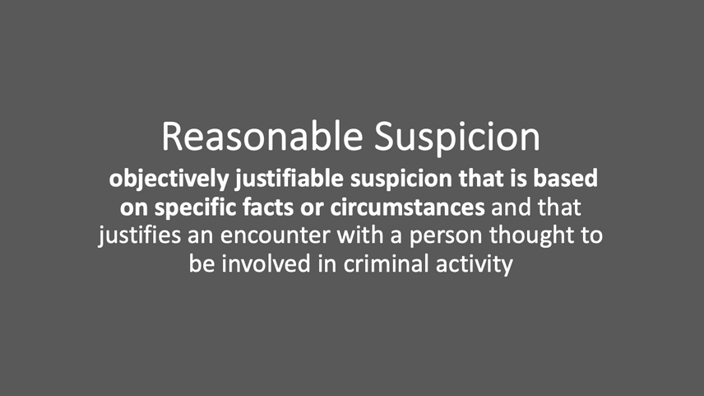
Burden of
Proof
Reasonable Suspicion
no evidence
Notes:
Next, is reasonable suspicion. This part of the mountain trek is the part the kids can make it to. You have started to make the hike, but you really haven't made it that far. It's still not too late to turn around...
In legal sense, we look at this as what an officer has to stop someone. If you are walking down the street in the middle of Texas summer with a ski mask and a trench coat, that's reasonable suspicion to stop you. However, if it is the Texas winter like we have been experiencing, its a little more justified.

Slide 50
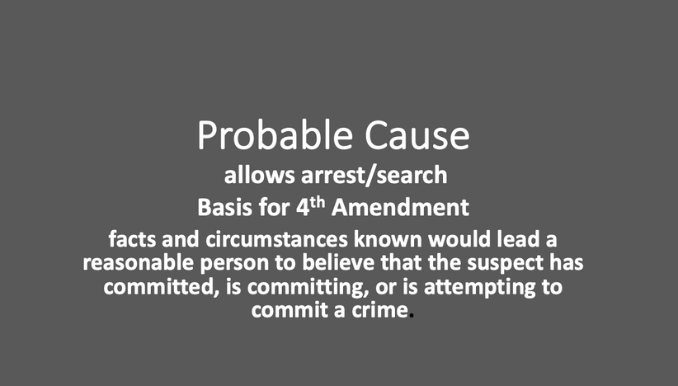
Burden of
Proof
Probable Cause
Reasonable Suspicion
no evidence
Notes:
Next, is reasonable suspicion. This part of the mountain trek is the part the kids can make it to. You have started to make the hike, but you really haven't made it that far. It's still not too late to turn around...
In legal sense, we look at this as what an officer has to stop someone. If you are walking down the street in the middle of Texas summer with a ski mask and a trench coat, that's reasonable suspicion to stop you. However, if it is the Texas winter like we have been experiencing, its a little more justified.

Slide 51
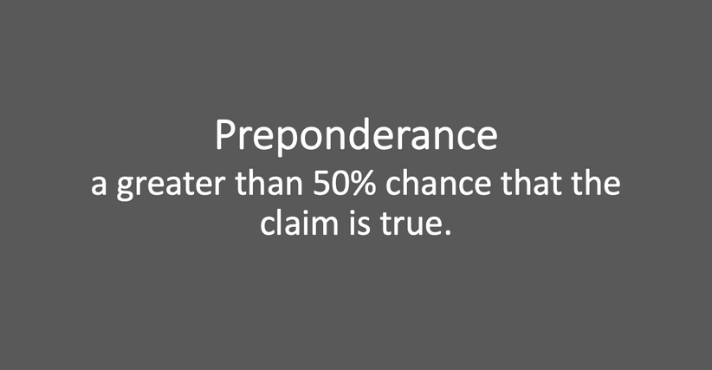
Burden of
Proof
Preponderance
Probable Cause
Reasonable Suspicion
no evidence
Notes:
Next, is reasonable suspicion. This part of the mountain trek is the part the kids can make it to. You have started to make the hike, but you really haven't made it that far. It's still not too late to turn around...
In legal sense, we look at this as what an officer has to stop someone. If you are walking down the street in the middle of Texas summer with a ski mask and a trench coat, that's reasonable suspicion to stop you. However, if it is the Texas winter like we have been experiencing, its a little more justified.

Slide 52
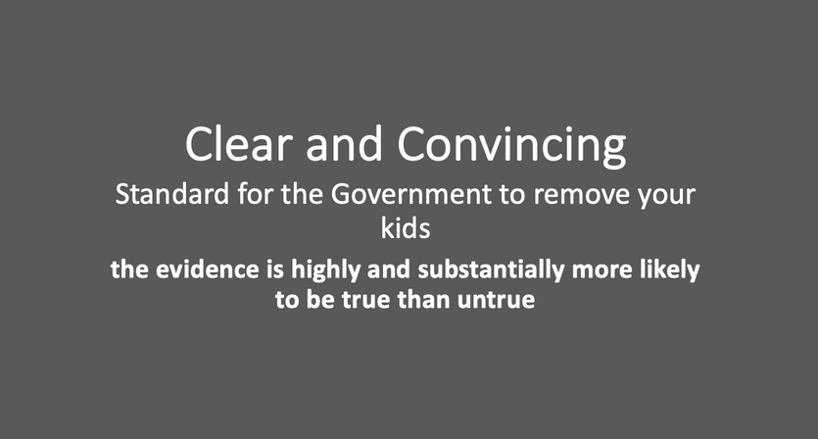
Burden of
Proof
Clear and Convincing
Preponderance
Probable Cause
Reasonable Suspicion
no evidence
Notes:
Next, is reasonable suspicion. This part of the mountain trek is the part the kids can make it to. You have started to make the hike, but you really haven't made it that far. It's still not too late to turn around...
In legal sense, we look at this as what an officer has to stop someone. If you are walking down the street in the middle of Texas summer with a ski mask and a trench coat, that's reasonable suspicion to stop you. However, if it is the Texas winter like we have been experiencing, its a little more justified.

Slide 53
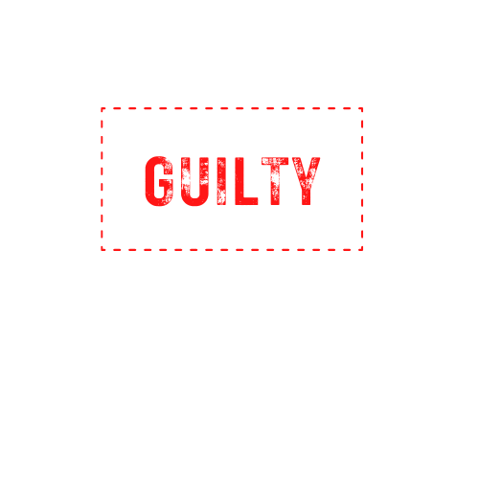
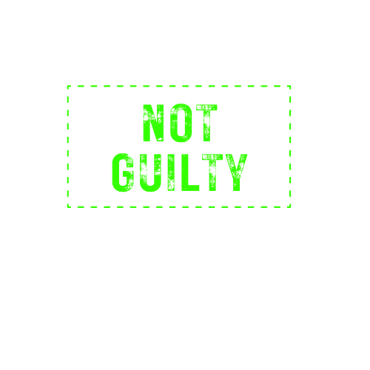

Beyond a
Reasonable Doubt
Any Reasonable
Doubt
Burden of
Proof
Clear and Convincing
Preponderance
Probable Cause
Reasonable Suspicion
no evidence
Notes:
Next, is reasonable suspicion. This part of the mountain trek is the part the kids can make it to. You have started to make the hike, but you really haven't made it that far. It's still not too late to turn around...
In legal sense, we look at this as what an officer has to stop someone. If you are walking down the street in the middle of Texas summer with a ski mask and a trench coat, that's reasonable suspicion to stop you. However, if it is the Texas winter like we have been experiencing, its a little more justified.

Slide 54
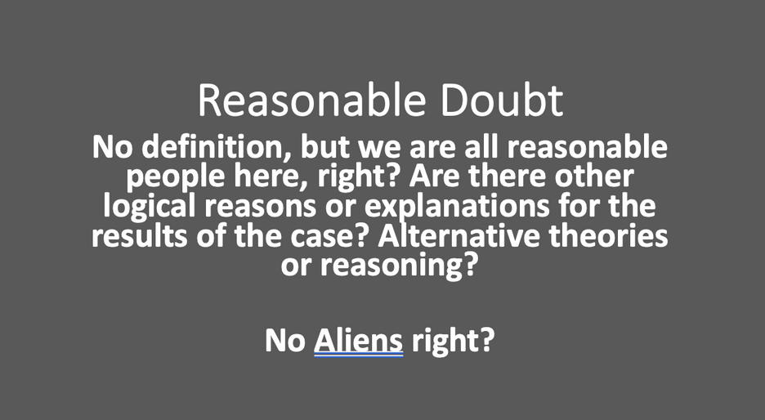
Beyond all
Reasonable Doubt
A Reasonable
Doubt
Burden of
Proof
Clear and Convincing
Preponderance
Probable Cause
Reasonable Suspicion
no evidence
Notes:
Next, is reasonable suspicion. This part of the mountain trek is the part the kids can make it to. You have started to make the hike, but you really haven't made it that far. It's still not too late to turn around...
In legal sense, we look at this as what an officer has to stop someone. If you are walking down the street in the middle of Texas summer with a ski mask and a trench coat, that's reasonable suspicion to stop you. However, if it is the Texas winter like we have been experiencing, its a little more justified.

Slide 55
Second Rule of Trial
Proof Beyond and to the Exclusion of All Reasonable Doubt
If the State only proves that there was probable cause (maybe), the verdict must be ________?

Slide 56
Second Rule of Trial
Proof Beyond and to the Exclusion of All Reasonable Doubt
If the State only proves that there was probable cause (maybe) for DWI, the verdict must be NOT GUILTY.

Slide 57
Second Rule of Trial
Proof Beyond and to the Exclusion of All Reasonable Doubt
If the State only proves that there was probable cause (maybe) for DWI, the verdict must be NOT GUILTY.
If the State only proves DWI to a preponderance of the evidence (greater weight of the evidence – more than 50 percent), the verdict must be ___________?

Slide 58
Second Rule of Trial
Proof Beyond and to the Exclusion of All Reasonable Doubt
If the State only proves that there was probable cause (maybe) for DWI, the verdict must be NOT GUILTY.
If the State only proves DWI to a preponderance of the evidence (greater weight of the evidence – more than 50 percent), the verdict must be NOT GUILTY.

Slide 59
Second Rule of Trial
Proof Beyond and to the Exclusion of All Reasonable Doubt
If the State only proves that there was probable cause (maybe), the verdict must be NOT GUILTY.
If the State only proves DWI to a preponderance of the evidence (greater weight of the evidence – more than 50 percent), the verdict must be NOT GUILTY.
If the State only proves DWI by clear and convincing evidence (where you have a firm belief that the allegations are true), the verdict must be ________?

Slide 60
Second Rule of Trial
Proof Beyond and to the Exclusion of All Reasonable Doubt
If the State only proves that there was probable cause (maybe), the verdict must be NOT GUILTY.
If the State only proves DWI to a preponderance of the evidence (greater weight of the evidence – more than 50 percent), the verdict must be NOT GUILTY.
If the State only proves DWI by clear and convincing evidence (where you have a firm belief that the allegations are true), the verdict must be NOT GUILTY.

Slide 61
Second Rule of Trial
Proof Beyond and to the Exclusion of All Reasonable Doubt
If the State only proves that there was probable cause (maybe), the verdict must be NOT GUILTY.
If the State only proves DWI to a preponderance of the evidence (greater weight of the evidence – more than 50 percent), the verdict must be NOT GUILTY.
If the State only proves DWI by clear and convincing evidence (where you have a firm belief that the allegations are true), the verdict must be NOT GUILTY.
If after hearing the evidence, you are just not sure if the State has proved guilt beyond and to the exclusion of all reasonable doubt (you just do not know one way or the other), the verdict must be ______?

Slide 62
Second Rule of Trial
Proof Beyond and to the Exclusion of All Reasonable Doubt
If the State only proves that there was probable cause (maybe), the verdict must be NOT GUILTY.
If the State only proves DWI to a preponderance of the evidence (greater weight of the evidence – more than 50 percent), the verdict must be NOT GUILTY.
If the State only proves DWI by clear and convincing evidence (where you have a firm belief that the allegations are true), the verdict must be NOT GUILTY.
If after hearing the evidence, you are just not sure if the State has proved guilt beyond and to the exclusion of all reasonable doubt (you just do not know one way or the other), the verdict must be NOT GUILTY.

Slide 63
Second Rule of Trial
Proof Beyond and to the Exclusion of All Reasonable Doubt
If the State only proves that there was probable cause (maybe), the verdict must be NOT GUILTY.
If the State only proves DWI to a preponderance of the evidence (greater weight of the evidence – more than 50 percent), the verdict must be NOT GUILTY.
If the State only proves DWI by clear and convincing evidence (where you have a firm belief that the allegations are true), the verdict must be NOT GUILTY.
If after hearing the evidence, you are just not sure if the State has proved guilt beyond and to the exclusion of all reasonable doubt (you just do not know one way or the other), the verdict must be NOT GUILTY.
If after hearing the evidence you believe beyond a reasonable doubt that Gonzalo did not have the normal use of his mental or physical faculties, but you are not sure if it was because of alcohol or for some other reason, the verdict must be _______?

Slide 64
Second Rule of Trial
Proof Beyond and to the Exclusion of All Reasonable Doubt
If the State only proves that there was probable cause (maybe), the verdict must be NOT GUILTY.
If the State only proves DWI to a preponderance of the evidence (greater weight of the evidence – more than 50 percent), the verdict must be NOT GUILTY.
If the State only proves DWI by clear and convincing evidence (where you have a firm belief that the allegations are true), the verdict must be NOT GUILTY.
If after hearing the evidence, you are just not sure if the State has proved guilt beyond and to the exclusion of all reasonable doubt (you just do not know one way or the other), the verdict must be NOY GUILTY.
If after hearing the evidence you believe beyond a reasonable doubt that Gonzalo did not have the normal use of her mental or physical faculties, but you are not sure if it was because of alcohol or for some other reason, the verdict must be NOT GUILTY.

Slide 65
Second Rule of Trial
Proof Beyond and to the Exclusion of All Reasonable Doubt
Where Can Reasonable Doubt Come From?
From the evidence itself.

Slide 66
Second Rule of Trial
Proof Beyond and to the Exclusion of All Reasonable Doubt
Where Can Reasonable Doubt Come From?
From the Evidence Itself.
From the Lack of Evidence.

Slide 67
Second Rule of Trial
Proof Beyond and to the Exclusion of All Reasonable Doubt
Where Can Reasonable Doubt Come From?
From the Evidence Itself.
From the Lack of Evidence.
From Unanswered Questions that you have.

Slide 68
Second Rule of Trial
Proof Beyond and to the Exclusion of All Reasonable Doubt
Where Can Reasonable Doubt Come From?
From the Evidence Itself.
From the Lack of Evidence.
From Unanswered Questions that you have.
Inconsistencies in the Evidence.

Slide 69
Second Rule of Trial
Proof Beyond and to the Exclusion of All Reasonable Doubt
Where Can Reasonable Doubt Come From?
From the Evidence Itself.
From the Lack of Evidence.
From Unanswered Questions that you have.
Inconsistencies in the Evidence.
Credibility of the Evidence – do not believe some or all.

Slide 70
Second Rule of Trial
Proof Beyond and to the Exclusion of All Reasonable Doubt
Where Can Reasonable Doubt Come From?
From the Evidence Itself.
From the Lack of Evidence.
From Unanswered Questions that you have.
Inconsistencies in the Evidence.
Credibility of the Evidence – do not believe some or all.
Weight of the Evidence – just not enough.

Slide 71
Second Rule of Trial
Proof Beyond and to the Exclusion of All Reasonable Doubt
Where Can Reasonable Doubt Come From?
From the Evidence Itself.
From the Lack of Evidence.
From Unanswered Questions that you have.
Inconsistencies in the Evidence.
Credibility of the Evidence – do not believe some or all.
Weight of the Evidence – just not enough.
Not proven to you.

Slide 72
Second Rule of Trial
Proof Beyond and to the Exclusion of All Reasonable Doubt
Where Can Reasonable Doubt Come From?
From the Evidence Itself.
From the Lack of Evidence.
From Unanswered Questions that you have.
Inconsistencies in the Evidence.
Credibility of the Evidence – do not believe some or all.
Weight of the Evidence – just not enough.
Not proven to you.
Specific Reasonable Doubt – one or several.

Slide 73
Second Rule of Trial
Proof Beyond and to the Exclusion of All Reasonable Doubt
You do not need to have the same reasonable doubt as anyone or everyone else.
Each person may have their own even if it is not shared by anyone else.
It is personal to you.

Slide 74
Third Rule of Trial
Burden of Proof
The prosecution has the burden of proving the defendant guilty and it must do so by proving each and every element of the offense charged beyond a reasonable doubt and if it fails to do so, you must acquit the defendant.

Slide 75
Third Rule of Trial
Burden of Proof
Only and always on the State.

Slide 76
Third Rule of Trial
Burden of Proof
Only and always on the State.
We (the defense) never have to prove or disprove anything.

Slide 77
Third Rule of Trial
Burden of Proof
Only and always on the State.
We (the defense) never have to prove or disprove anything.
It means that the State has the Responsibility for the Evidence.

Slide 78
Third Rule of Trial
Burden of Proof
Only and always on the State.
We (the defense) never have to prove or disprove anything.
It means that the State has the Responsibility for the Evidence.
If you want more evidence, who do you hold the lack of evidence against?

Slide 79
Third Rule of Trial
Burden of Proof
Only and always on the State.
We (the defense) never have to prove or disprove anything.
It means that the State has the Responsibility for the Evidence.
If you want more evidence, who do you hold the lack of evidence against? The State because they have the Responsibility for the Evidence and the Burden of Proof.

Slide 80
Third Rule of Trial
Burden of Proof
Who is on trial here?

Slide 81
Third Rule of Trial
Burden of Proof
Who is on trial here?
Gonzalo ______________ ???????

Slide 82
Third Rule of Trial
Burden of Proof
Who is on trial here?
Gonzalo ______________ ???????
NO – The State, its case, and its evidence is on trial because it has the Burden of Proof and Gonzalo has the presumption of innocence.

Slide 83
Third Rule of Trial
Burden of Proof
Some say that they must hear something from the defense before they could ever find Gonzalo not guilty and that if they hear nothing from the defense, they cannot find Gonzalo not guilty.

Slide 84
Third Rule of Trial
Burden of Proof
Some say that they must hear something from the defense before they could ever find Gonzalo not guilty and that if they hear nothing from the defense, they cannot find Gonzalo not guilty.
Does anyone feel that way?

Slide 85
Third Rule of Trial
Burden of Proof
If the State rests, and you have a reasonable doubt or are not sure if it has been proven beyond and to the exclusion of all reasonable doubt, and the defense produces no evidence, the verdict has to be ______?

Slide 86
Third Rule of Trial
Burden of Proof
If the State rests, and you have a reasonable doubt or are not sure if it has been proven beyond and to the exclusion of all reasonable doubt, and the defense produces no evidence, the verdict has to be NOT GUILTY.

Slide 87
Decision To Take or Not to Take
A Breath or Blood Test
Is it legal or illegal to decline to take a breath or blood test?

Slide 88
Decision To Take or Not to Take
A Breath or Blood Test
Is it legal or illegal to decline to take a breath or blood test? LEGAL

Slide 89
Decision To Take or Not to Take
A Breath or Blood Test
Is it legal or illegal to decline to take a breath or blood test? Legal
The law gives every person the option to decline to take a breath or blood test and requires that if a person declines none shall be taken unless the police get a search warrant. It is legal to just say no.

Slide 90
Decision Not to Take a
Breath or Blood Test
Is it legal or illegal to decline to take a breath or blood test?
The law gives every person the option to decline to take a breath or blood test and requires that if a person declines none shall be taken unless the police get a search warrant. It is perfectly legal to just say no.
Anyone fundamentally disagree with that law?

Slide 91
Decision To Take or Not to Take
A Breath or Blood Test
Is it legal or illegal to decline to take a breath or blood test?
The law gives every person the option to decline to take a breath or blood test and requires that if a person declines none shall be taken unless the police get a search warrant. It is legal to just say no.
Does anyone believe that a person who declines to provide a breath or blood specimen would only do so because they know they are guilty?

Slide 92
Decision To Take or Not to Take
A Breath Test
Is it legal or illegal to decline to take a breath or blood test?
The law gives every person the option to decline to take a breath or blood test and requires that if a person declines none shall be taken unless the police get a search warrant. It is legal to just say no.
Does anyone believe that a person who declines to provide a breath or blood specimen would only do so because they know they are guilty?
What would a person who believes they are innocent and had nothing to hide do?

Slide 93
Drinking and Driving
Highway Slogan -- Drink, drive, __________.

Slide 94
Drinking and Driving
Highway Slogan -- Drink, drive, go to jail.

Slide 95
Drinking and Driving
Highway Slogan -- Drink, drive, go to jail.
Is it the law -- True or false?

Slide 96
Drinking and Driving
Highway Slogan -- Drink, drive, go to jail.
Is it the law -- True or false?
False: it is not the law: because it is not the law, should anyone be arrested simply for drinking and driving?

Slide 97
Drinking and Driving
Highway Slogan -- Drink, drive, go to jail.
Is it the law -- True or false?
False: it is not the law: because it is not the law, should anyone be arrested simply for drinking and driving?
If you believe that Gonzalo was drinking and driving, but you are not sure beyond all reasonable doubt if he was intoxicated, the verdict has to be _______?

Slide 98
Drinking and Driving
Highway Slogan -- Drink, drive, go to jail.
Is it the law -- True or false?
False: it is not the law: because it is not the law, should anyone be arrested simply for drinking and driving?
If you believe that Gonzalo was drinking and driving, but you are not sure beyond all reasonable doubt if he was intoxicated, the verdict has to be NOT GUILTY.

Slide 99
Police Exercises
Do you think that the exercises police ask people to do are a reliable way of distinguishing between someone who is intoxicated and someone who is not?

Slide 100
Police Exercises
Do you think that the exercises police ask people to do are a reliable ways of distinguishing between someone who is intoxicated and someone who is not?
Is any test or exercise meaningful if it cannot tell the difference between someone who is intoxicated and someone who is tired, uncoordinated, nervous, scared, has a medical condition, or is otherwise not able to do the test when not intoxicated?

Slide 101
Police Exercises
Who is certain they could do the police exercises perfectly right now?

Slide 102
Police Exercises
Who is certain they could do the police exercises perfectly right now?
If your failure to do them perfectly was going to result in the judge ordering you into custody right now, would you still be confident you could do them perfectly?

Slide 103
Police Exercises
Who is certain they could do the police exercises perfectly right now?
If your failure to do them perfectly was going to result in the judge ordering you into custody right now, would you still be confident you could do them perfectly?
Who is not sure if they could do the police exercises perfectly right now?

Slide 104
Breath and Blood Testing
What do you know about the breath and blood test machines?

Slide 105
Breath Testing
What do you know about the breath test machine in Texas?
Is any machine always accurate and reliable?

Slide 106
Breath Testing
What do you know about the breath test machine?
Is any machine always accurate and reliable?
Can you know that the results of a machine are wrong without knowing why it is wrong?

Slide 107
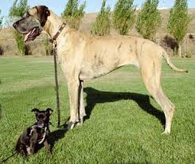
What is this?

Slide 108
What is this?
This is a Great Dane.
True or false?

Slide 109
What is this?
This is a Chihuahua?
True of false?
This is a Great Dane.
True or false?

Slide 110
What is this?
This is a Chihuahua?
True of false?
This is a Great Dane.
True or false?
I have a government DNA test report that says this is a Chihuahua?
Do you believe it?

Slide 111
What is this?
This is a Chihuahua?
True of false?
This is a Great Dane.
True or false?
I have a government DNA test report that says this is a Chihuahua?
Do you believe it?
Do you have to know why the DNA lab report is wrong to know that it must be wrong?

Slide 112
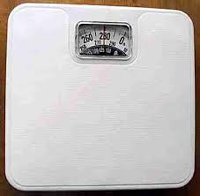
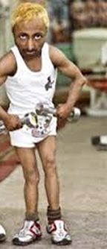
Accurate or Reliable?

Slide 113
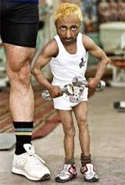
Accurate or Reliable?
Do you have to know why the scale is wrong to know that it must be wrong?

Slide 114
Jury Function
Some say it is acceptable to find someone charged with a crime guilty simply to send a message to that person or society.

Slide 115
Jury Function
Some say it is acceptable to find someone charged with a crime guilty simply to send a message to that person or society.
Does anyone feel that way?

Slide 116
Jury Function
Some say it is acceptable to find someone charged with a crime guilty simply to send a message to that person or society.
Does anyone feel that way?
Others say that it is only acceptable to find someone guilty if the State has proven them guilty beyond and to the exclusion of all reasonable doubt.

Slide 117
Jury Function
Some say it is acceptable to find someone charged with a crime guilty simply to send a message to that person or society.
Does anyone feel that way?
Others say that it is only acceptable to find someone guilty if the State has proven them guilty beyond and to the exclusion of all reasonable doubt.
Is sending a message ever a reason to find someone guilty?

Slide 118
Decision Making
6 Jurors means 6 verdicts.
Each person has the right to their own verdict.
If all six agree, then there is a group verdict.
If all six do not agree then there is not a group verdict. This is acceptable.

Slide 119
Decision Making
6 Jurors means 6 verdicts.
Each person has the right to their own verdict.
If all six agree, then there is a group verdict.
If all six do not agree then there is not a group verdict. This is acceptable.
Some people stick to their beliefs and others go along to get along with the group.
Which kind of person are you?

Slide 120
Decision Making
6 Jurors means 6 verdicts.
Each person has the right to their own verdict.
If all six agree, then there is a group verdict.
If all six do not agree then there is not a group verdict. This is acceptable.
Some people stick to their beliefs and others go along to get along with the group.
Which kind of person are you?
Some people give up their beliefs just to be done. Would you ever do that?

Slide 121
Last Three Questions
Is there anyone who has anything that you want or need to talk to us privately about?

Slide 122
Last Three Questions
Is there anyone who has anything that you want or need to talk to us privately about?
Is there any reason you cannot be here for trial through Thursday or Friday?

Slide 123
Last Three Questions
Is there anyone who has anything that you want or need to talk to us privately about?
Is there any reason you cannot be here for trial through Thursday or Friday?
Is there anything else we should know about you? If we just asked you the right question, we would learn something important that you would want to know if you were us.

Slide 124
Thank You
We look forward to seeing six of you serving on this jury to judge the State’s case.

